Slide 1
Achieving Our Vision 2020-2030
Reviewed June 2023

Slide 2
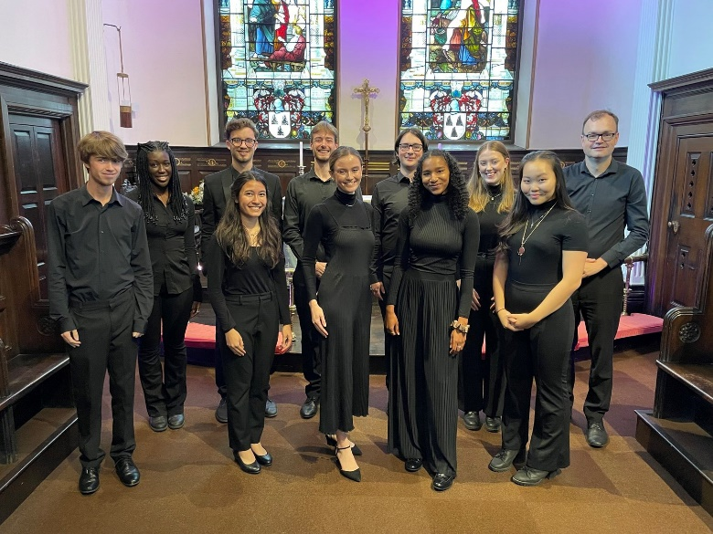
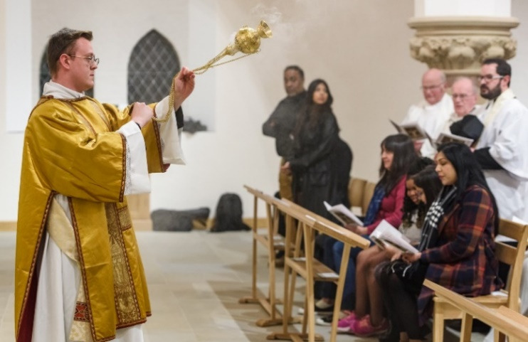
Our Vision
To be a worshipping, growing and transforming Christian presence at the heart of every community
Our Values
Faith, Hope and Love
Our Mission Goals
Growing – engaging new disciples in missionary church communities which are younger, more diverse, active and spiritually engaged.
Nurturing – helping new and existing disciples grow in their faith.
Serving - being present for all, speaking and asking prophetically for justice, supporting pastorally especially the vulnerable, deprived and excluded.

Slide 3
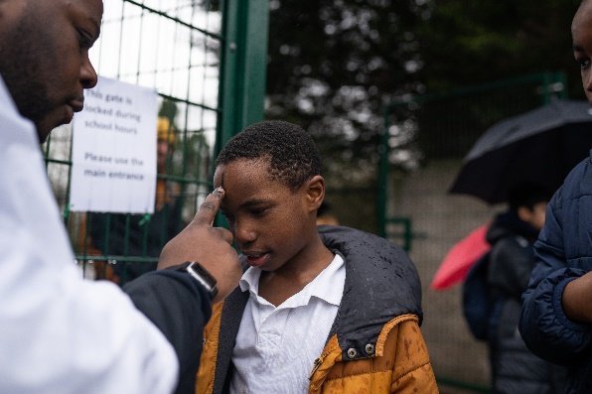
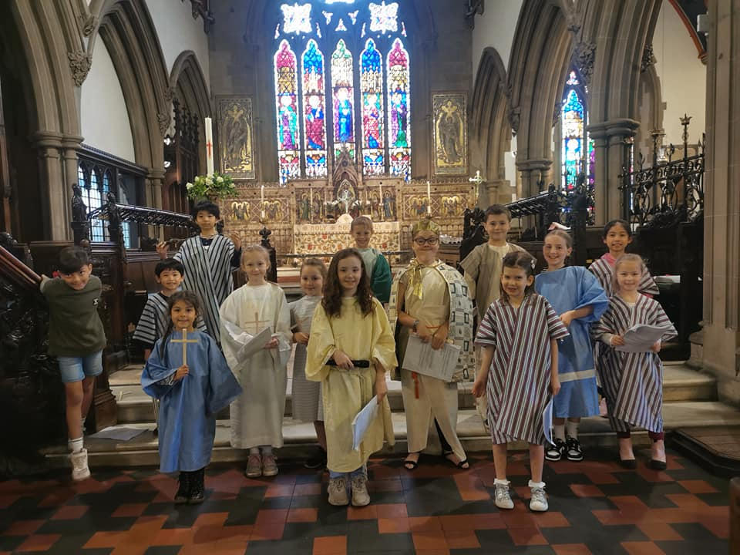
We are growing - a church for everyone
We appeal to all sorts of people – we are vibrant, living, God-centred communities.
People who weren’t involved ten years ago, feel comfortable here now.
There is a wide range of different traditions of prayer, praise and thanksgiving.
People of all ages can be together – everyone can belong.
We love inviting people along.
People experience the joy – as well as a sense of awe and wonder.
Our leaders and congregations reflect the diversity of our local communities.
Children and families have lots of fun here, as well as being safe.
We are good at reaching out to and inspiring young people.
Children and young people are leading the way in changing the way we do things.

Slide 4
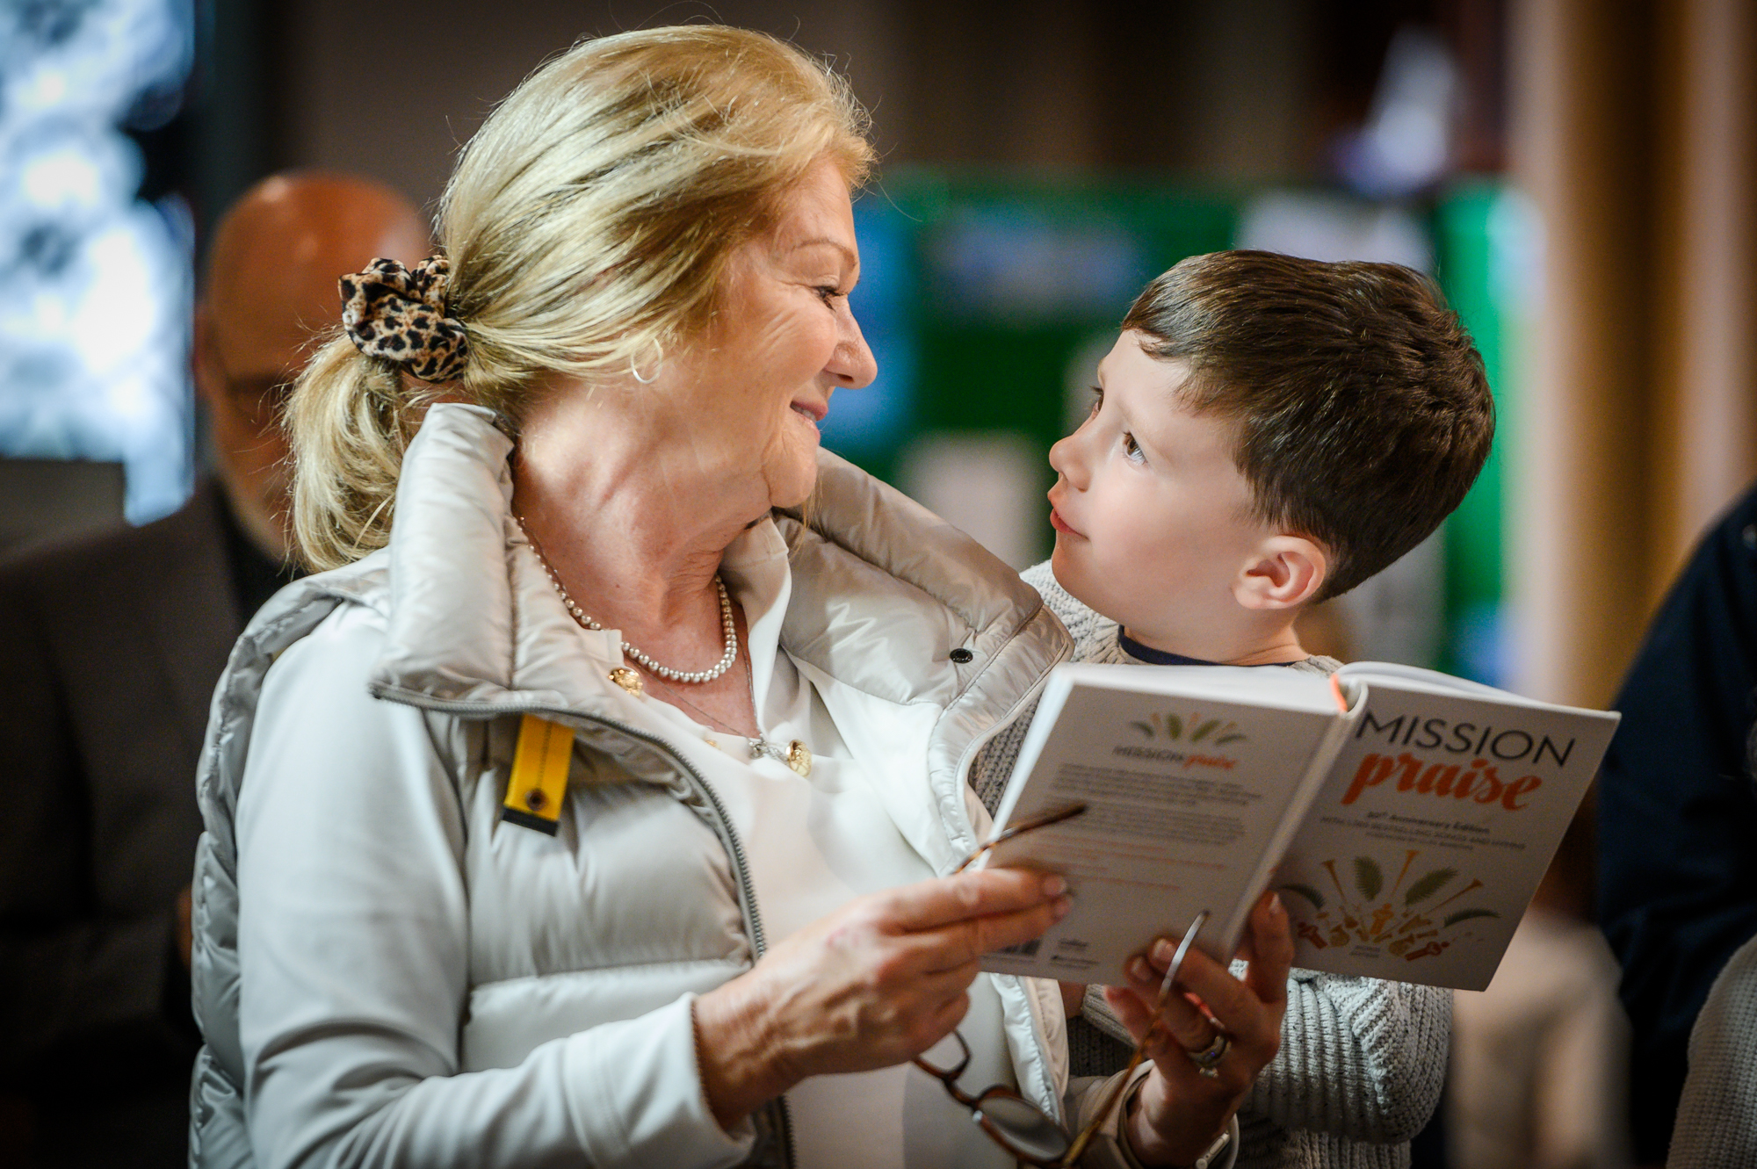
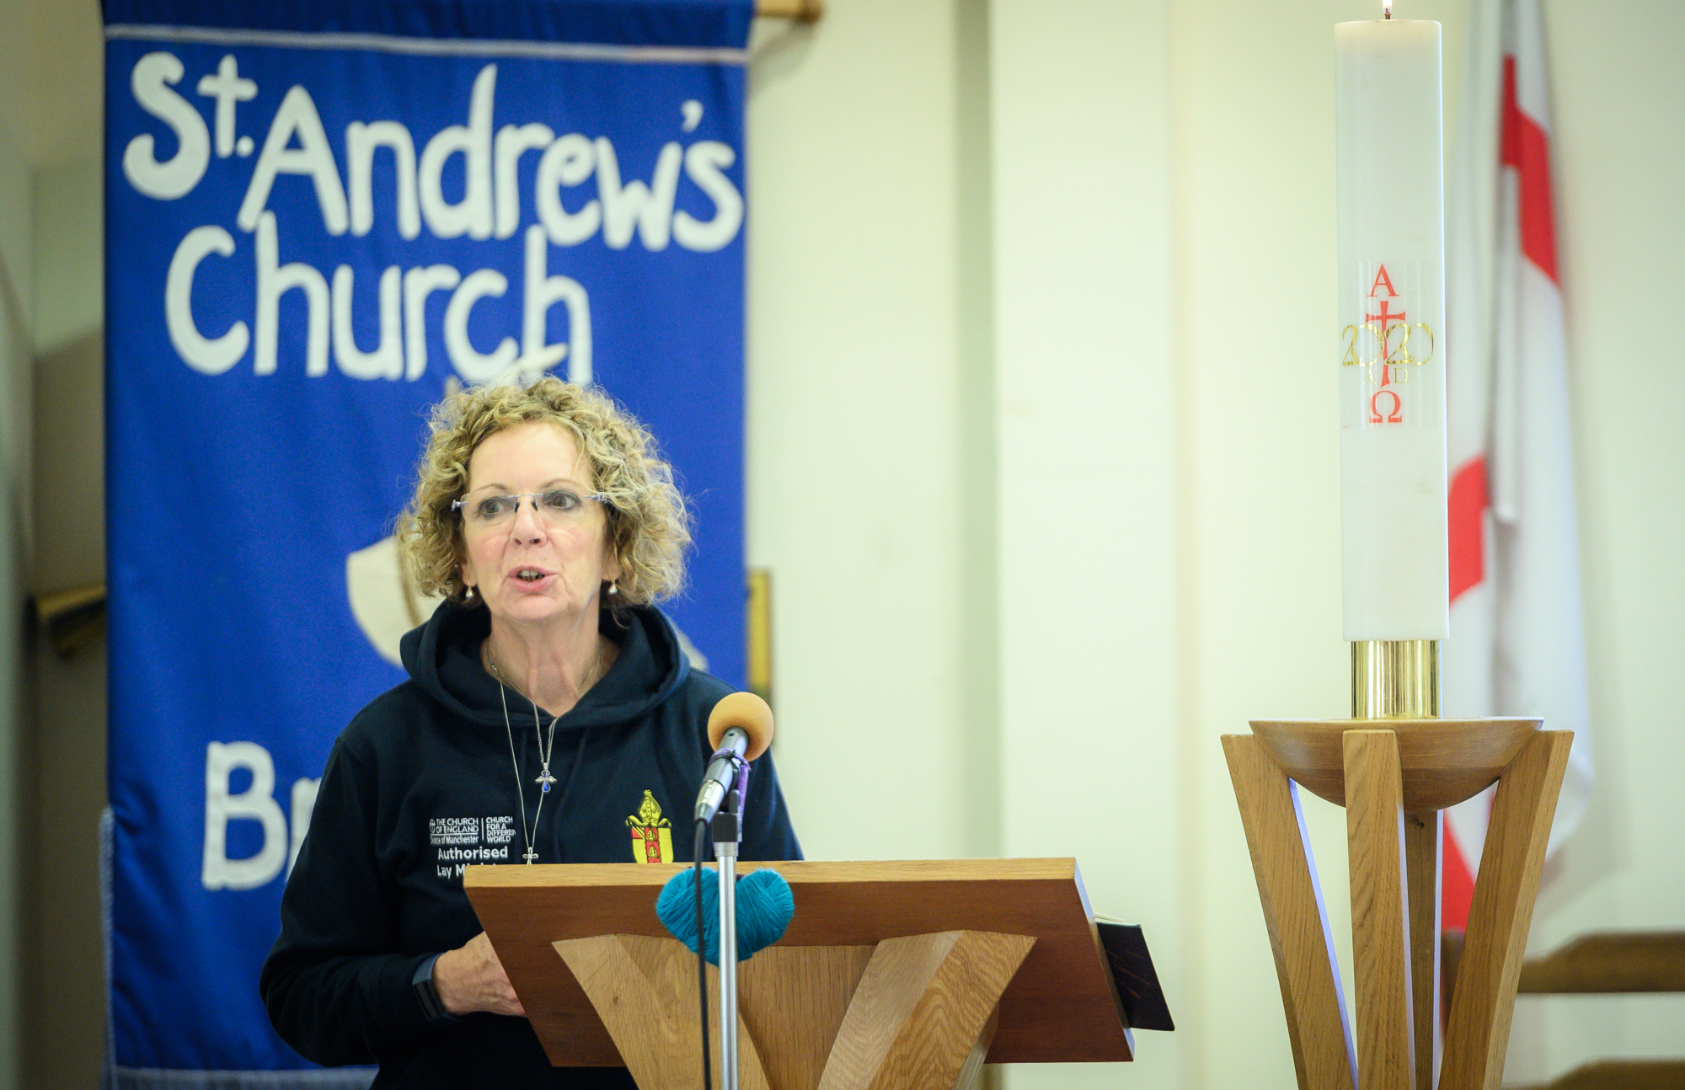
We are nurturing - a church where we are focused on discipleship and evangelism
We are able to develop our spiritual lives, teaching the Gospel and the faith.
We are imaginative with worship and liturgy – it’s not just about the written word.
We worship at different times during the week – not just on Sundays
We are able to tackle the deep, difficult questions.
We are able to develop our faith in a variety of ways – from small groups to social media.
We meet together in different local places – cafes, libraries, schools, home.
What we experience helps us live and share our faith in the rest of our lives.
There are opportunities for development and sharing expertise - for clergy and laity.
We are generous – with our time and talents and our financial support.
We have great leaders – clergy and laity - who get the best out of everyone.

Slide 5
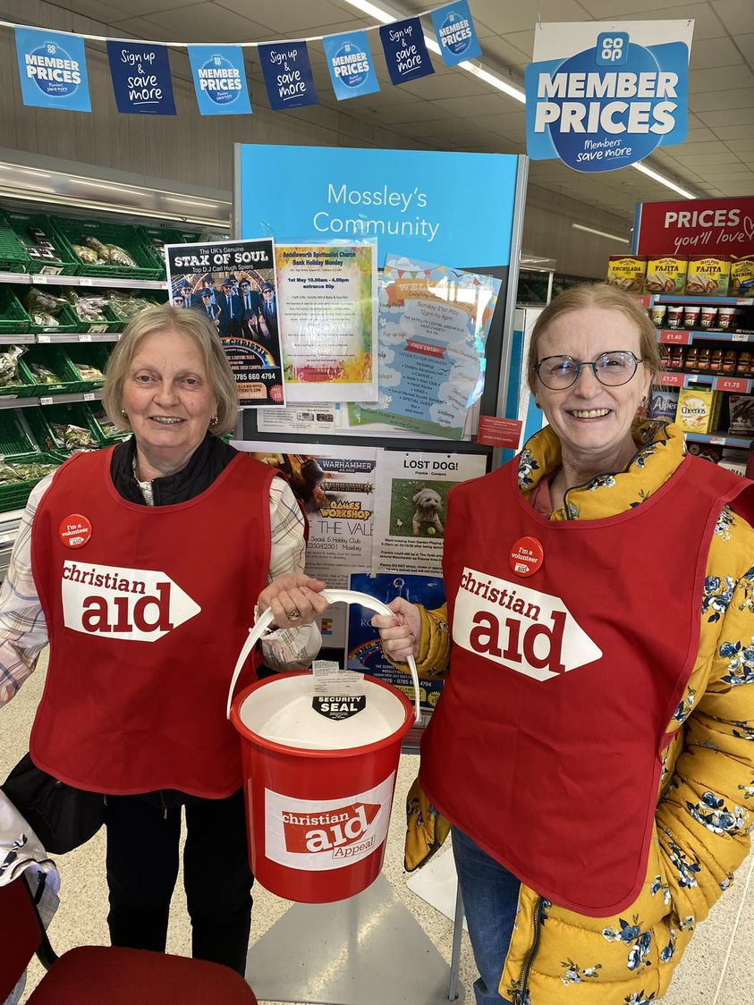
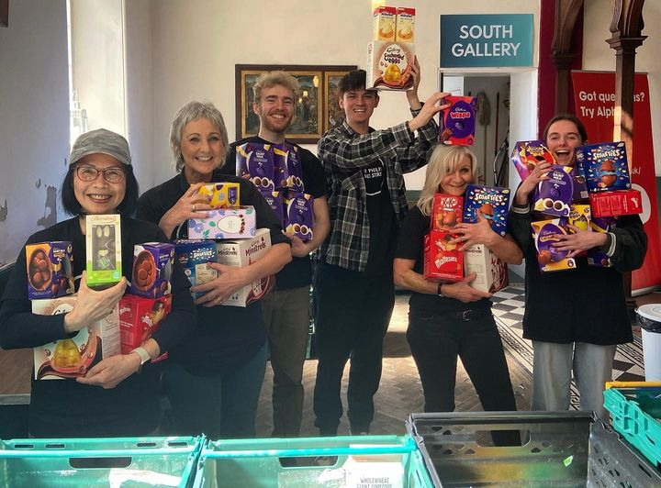
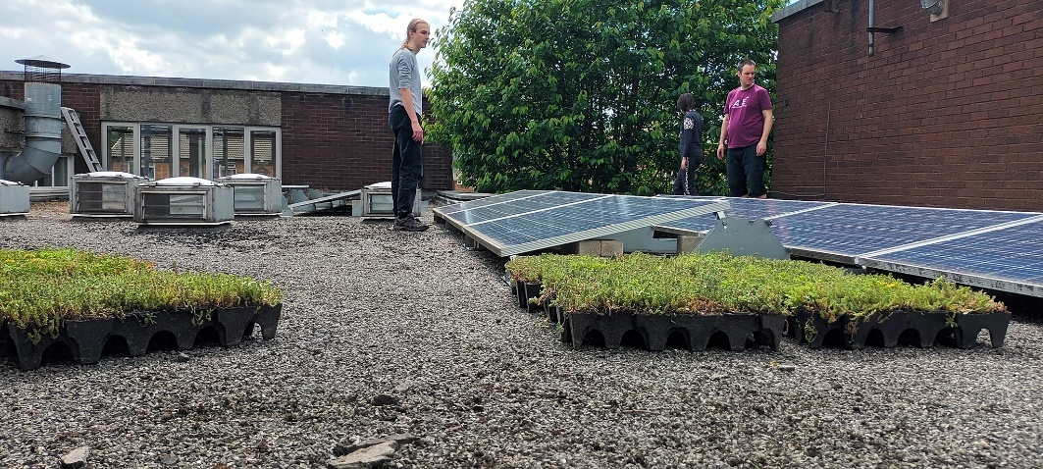
We are serving - a church which leads the way in every local community
We are good at working with other organisations and building local confidence.
People come to find out what we are doing and learn from us.
We are at the leading edge with our environmental projects.
We support and promote the creative arts.
We have a high profile – we are active and visible in our local communities.
We bring different communities and people of different faiths together
We are a base for lots of different activities.
We work closely with our schools and our chaplains working out in the community.
We are open and welcoming and our buildings are sustainable and accessible.
We support those who are deprived and excluded and speak out for justice and peace.
Title 2
The guideline font is size 24 to make it easy to read on a screen
Title 3
Please do adjust to suit your requirements

Slide 6
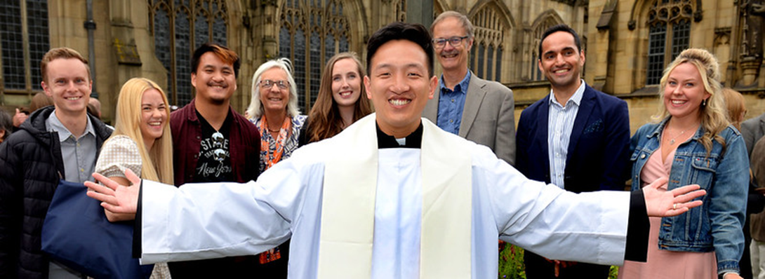
Where we want to be by 2030
Growing
The total number people attending church (Average Weekly Attendance) to grow to 31,500 – 1.5% of the population
The number of people in the 10% most deprived areas attending church to increase from 0.8% to 1.2% of the population
The number of children and young people under the age of 18 to increase from 26% to 32% of our congregations – to 10,500 children and young people.
Nurturing
The number of people attending discipleship courses each year to increase from 25% to 90% of our congregations
The number of children and adults baptised increasing from around 2,800 to 4,000 each year and the number of confirmations increasing from 650 to 1,000 each year
Our church leadership, as well as our new ordinands, to reflect the diversity of our congregations.
Serving
30% of our parishes to be offering targeted support to counter loneliness and isolation
Net zero carbon for our diocese
Title 2
Title 3

Slide 7
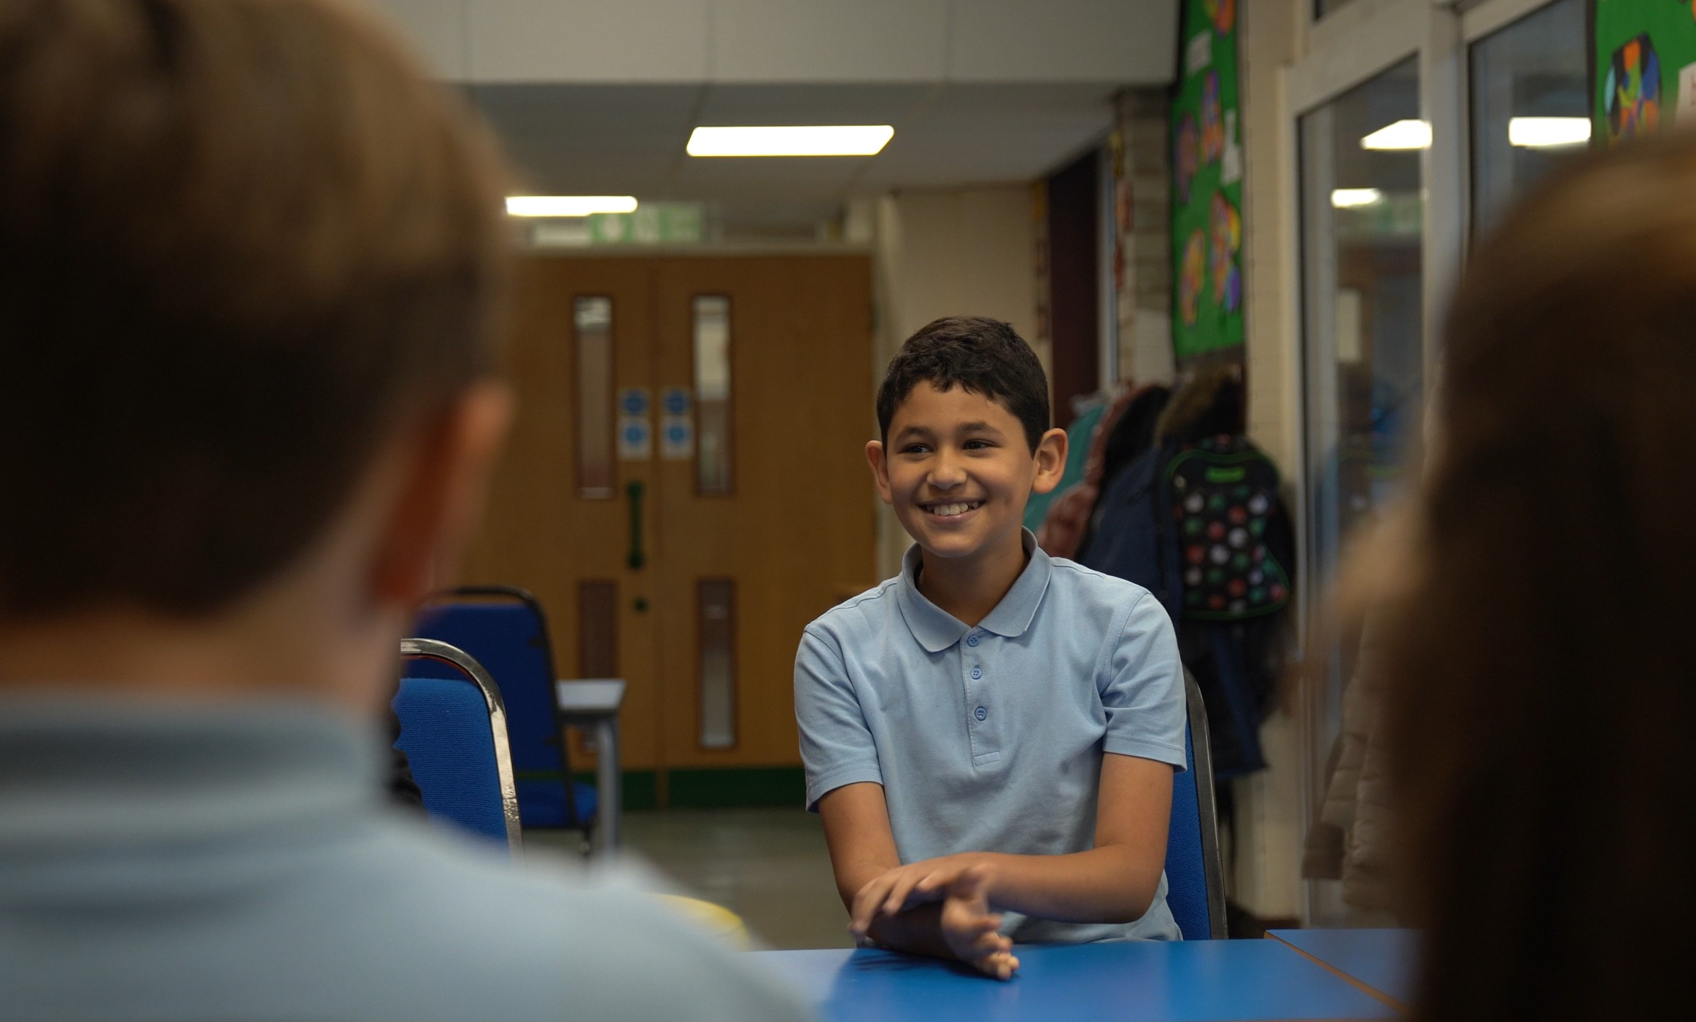
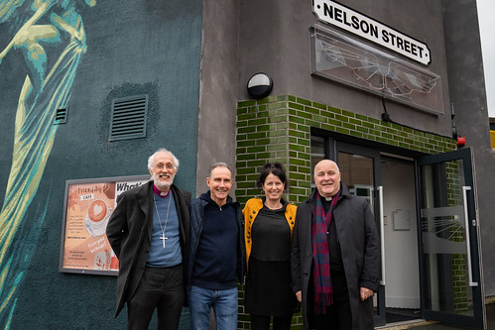
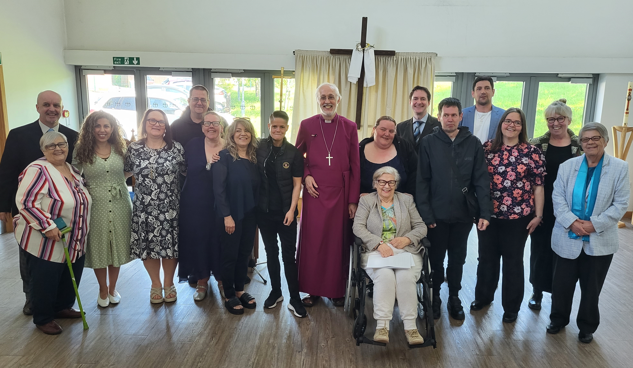
Our achievements – 2020, 2021 and 2022
Growing
Children Changing Places project in Bolton
Two new resource churches – St Werburgh’s and Nelson Street
The Antioch church planting network
Funding for a new resource church for Manchester City Centre
61 candidates for ordination training
Stepping Stones for Growth training resources
Nurturing
140 Authorised Lay Ministers commissioned
19 Readers licensed
#MoreThanSunday pilot
Foundations for Ministry courses delivered locally
Focal ministry proposals ready for roll-out from 2023
Title 2
The guideline font is size 24 to make it easy to read on a screen
Title 3

Slide 8
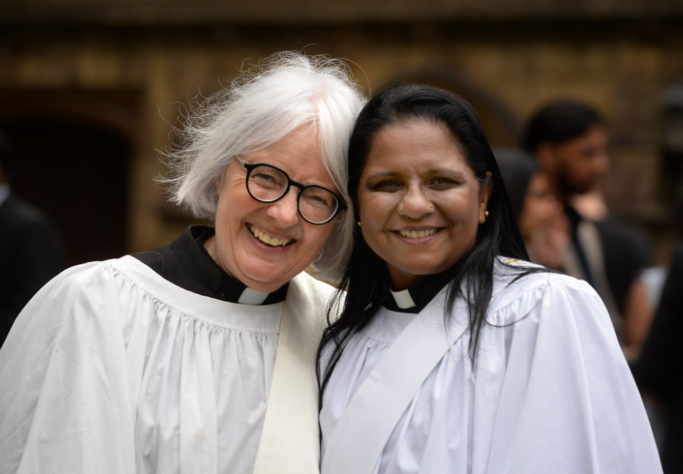
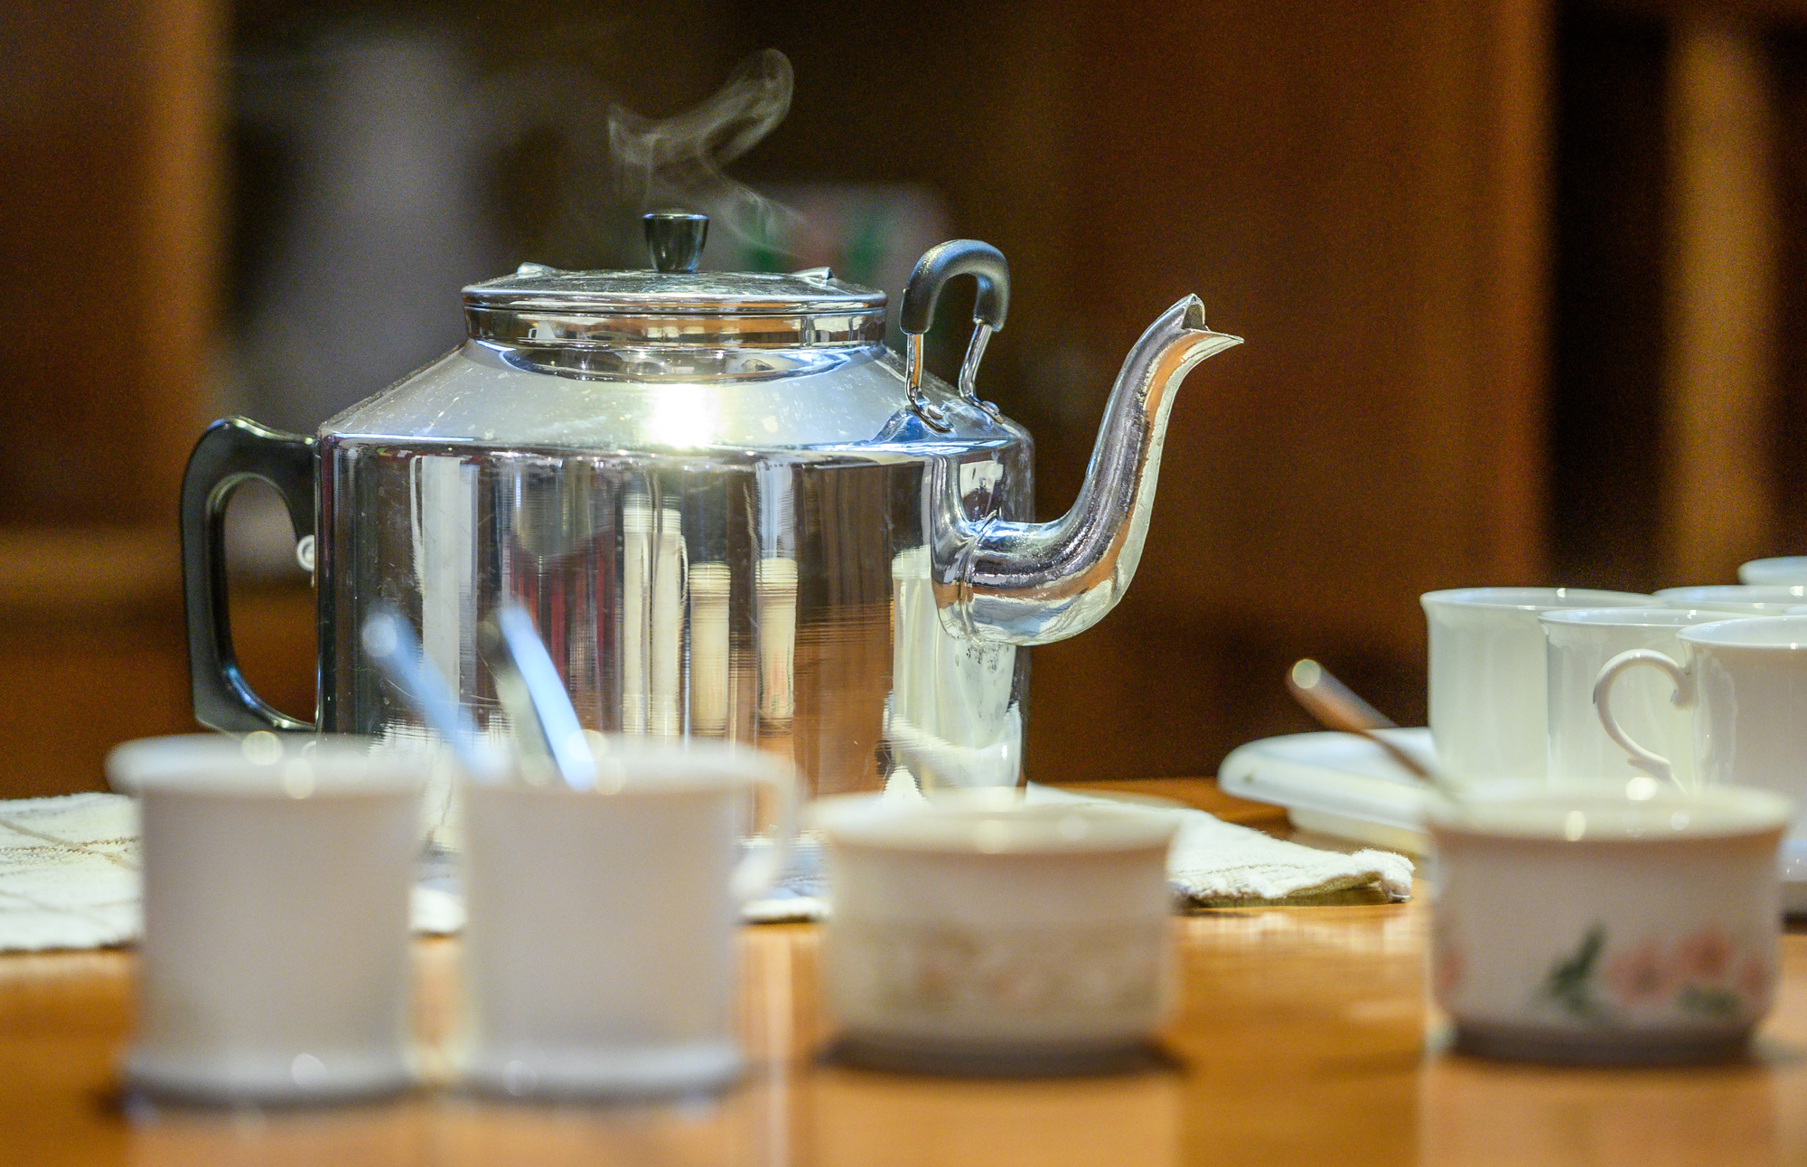
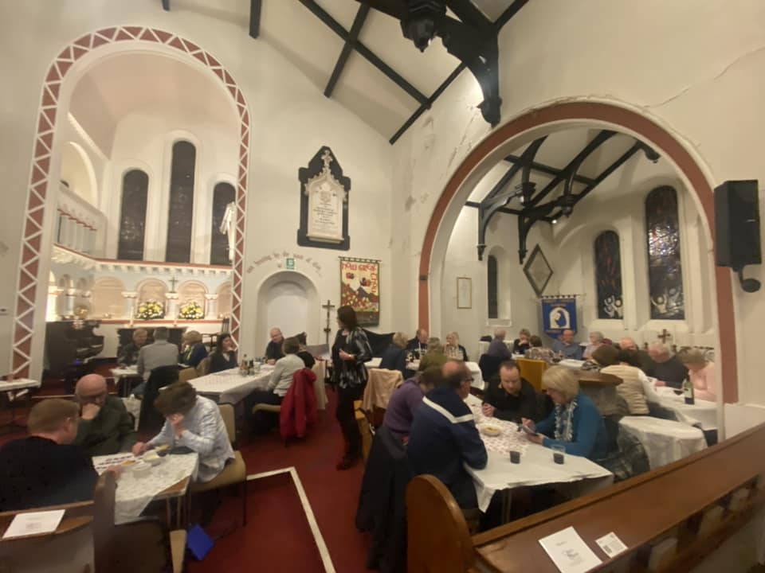
Our achievements – 2020, 2021 and 2022
Serving
Our parishes involved in 670 social action projects
Fifty churches signed up as places of welcome
Eco Church – 38 bronze awards and 19 silver awards
142 churches registered for eco-church
Energy Footprint Tool completed by 50% of parishes
Our Transformation Programme
Additional funding of £5m from the Church Commissioners
Deanery changes – reduced from twenty to seven
Full-time Area Deans appointed along with deanery support officers
Mission Community boundaries agreed
25 out of 33 mission community leaders appointed
Title 2
Title 3

Slide 9
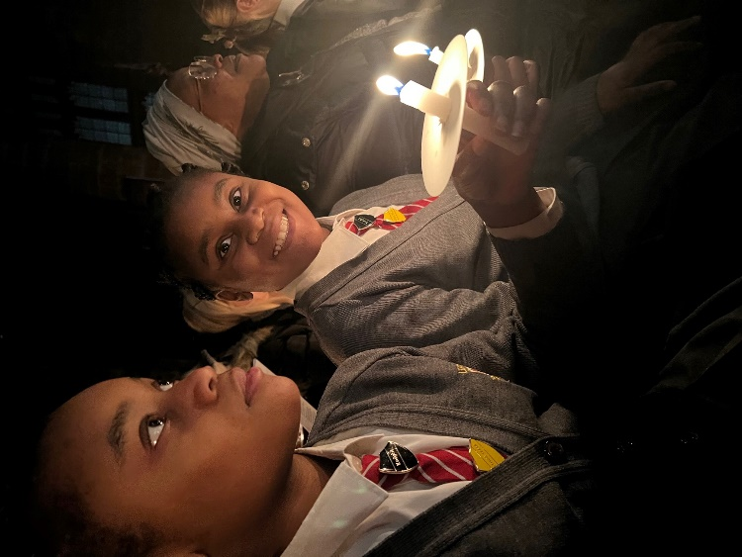
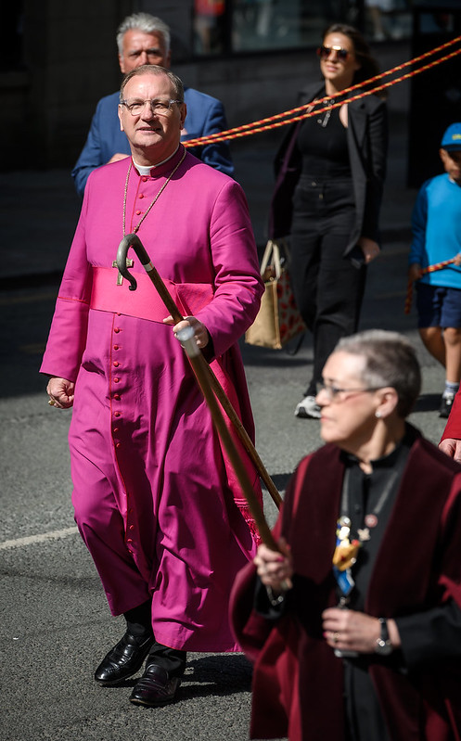
Mission Goal - Growing (2023 – 2030)
Set up new resource churches across the diocese
Plant new congregations
Support and encourage chaplaincies
Enable every parish to run an enquirers course
Support all parishes and mission communities in maintaining a consistent outward focus
Develop and train our clergy, lay leaders and chaplains
Reach out to children and young families through #ManDio Growing Faith programme
Develop plans for town centres and estates, and the city centre
Work with our international congregations
Focus on vocations – clergy and lay – so we nurture a new diverse generation of leaders
Title 2
Title 3

Slide 10
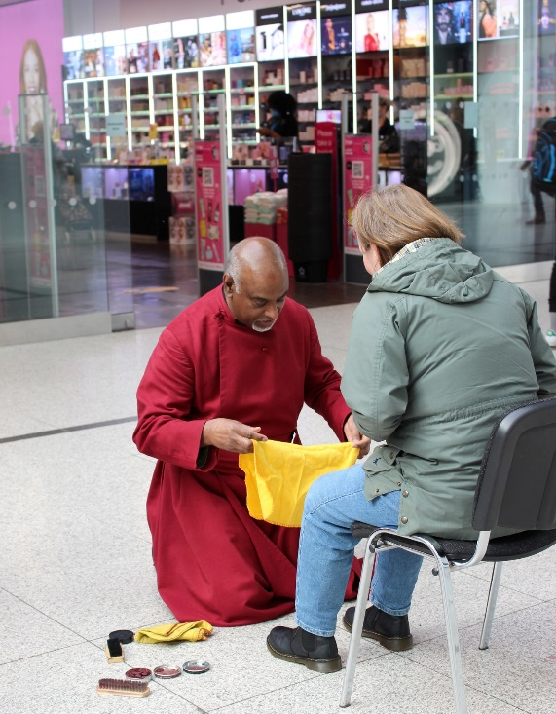
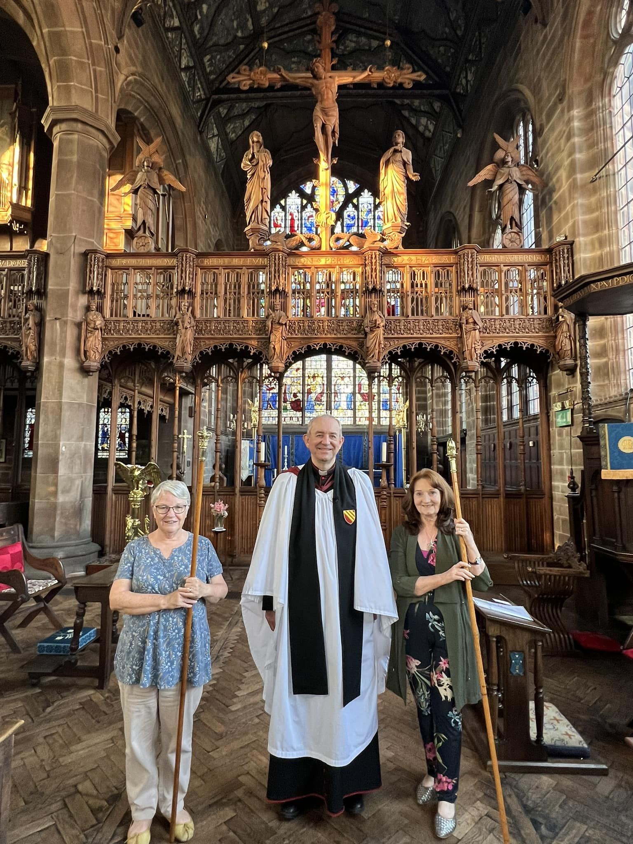
Mission Goal - Nurturing (2023 – 2030)
Establish a Diocesan Prayer Community
Recruit, train and commission focal leaders
Encourage all church members to participate in discipleship development
Ensure #MoreThanSunday is available in every mission community
Ensure the #ManDio Growing Faith programme is able to support children and young people in exploring their faith
Continue to develop our lay training
Promote the vocation and ministry of lay church officers in our parishes and other lay governance leaders
Establish leadership pathways for lay leaders, including PCC members and those supporting local and diocesan governance.
Title 2
The guideline font is size 24 to make it easy to read on a screen
Title 3

Slide 11
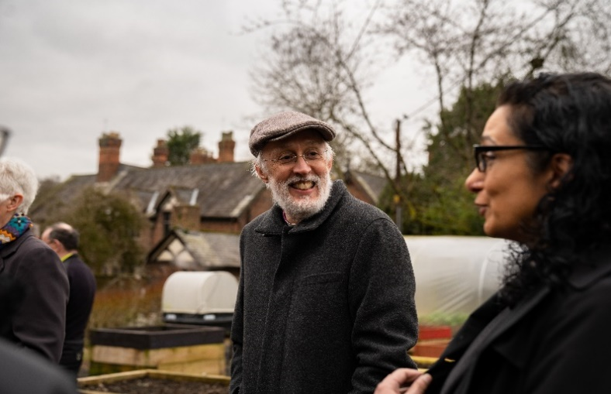
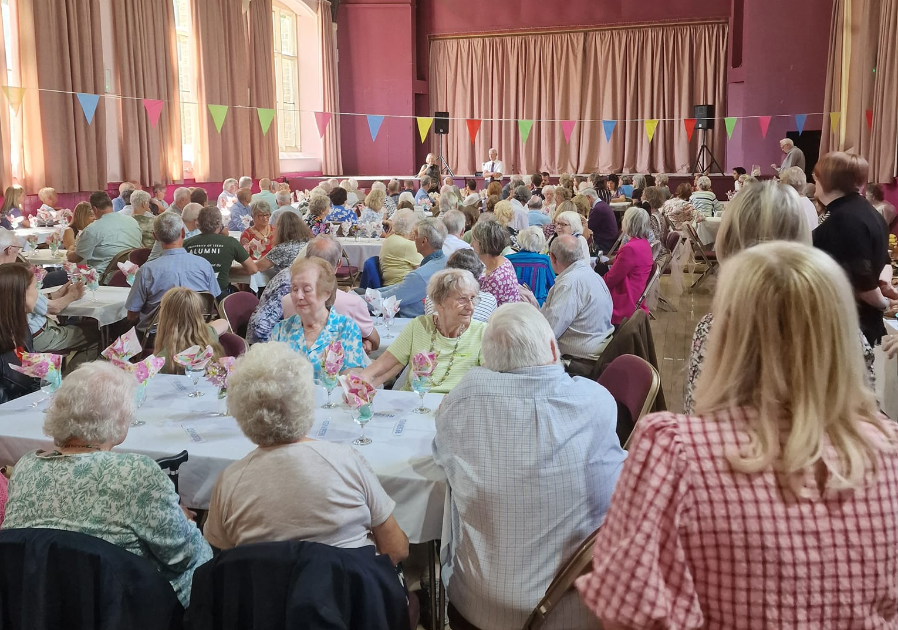
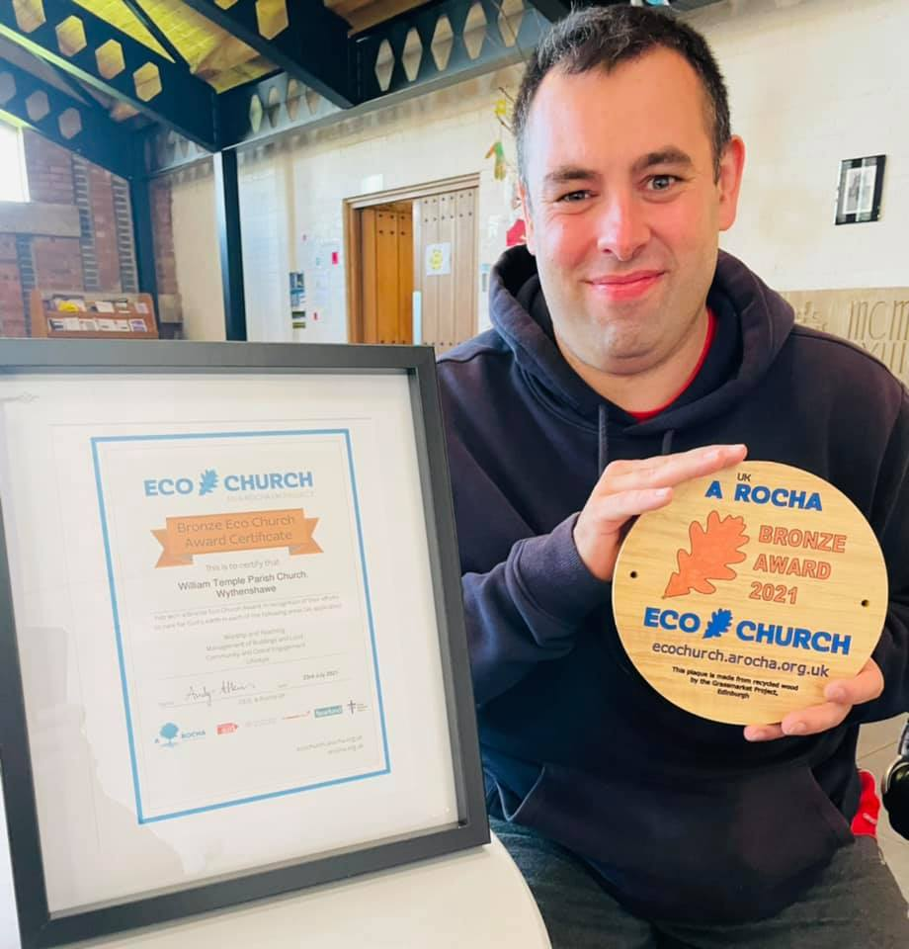
Mission Goal - Serving (2023 – 2030)
Grow our network of Places of Welcome
Support our parishes with social action to combat isolation, homelessness, food poverty and debt
Expand and deepen local engagement with the Eco Church programme
Work towards net zero carbon by supporting parishes and schools to measure their energy use through the Energy Footprint Tool
Develop a decarbonisation plan for our diocese and secure implementation funding to achieve net zero carbon.
Title 2
The guideline font is size 24 to make it easy to read on a screen
Title 3

Slide 12
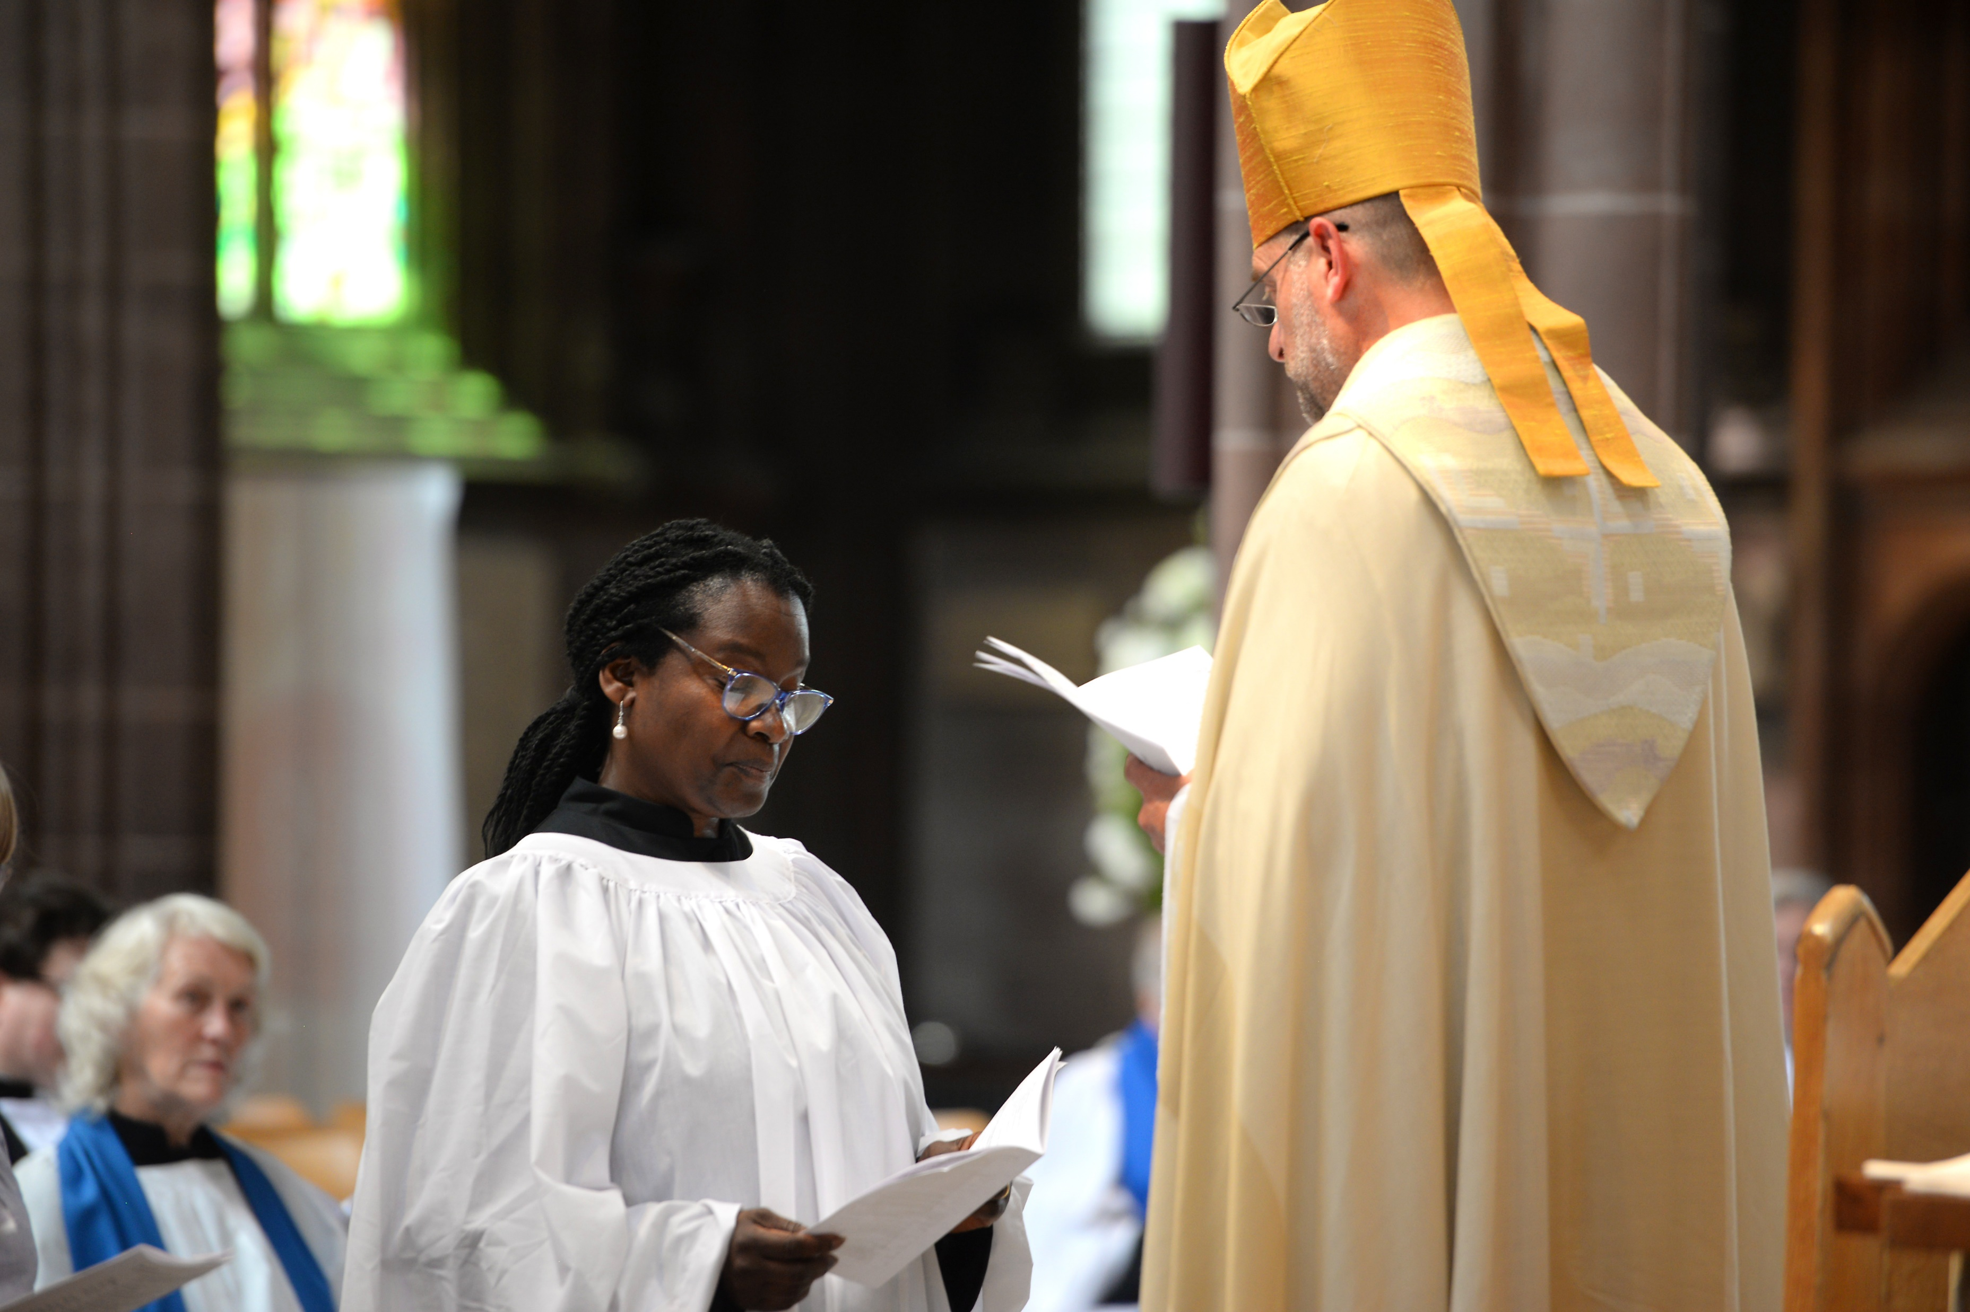
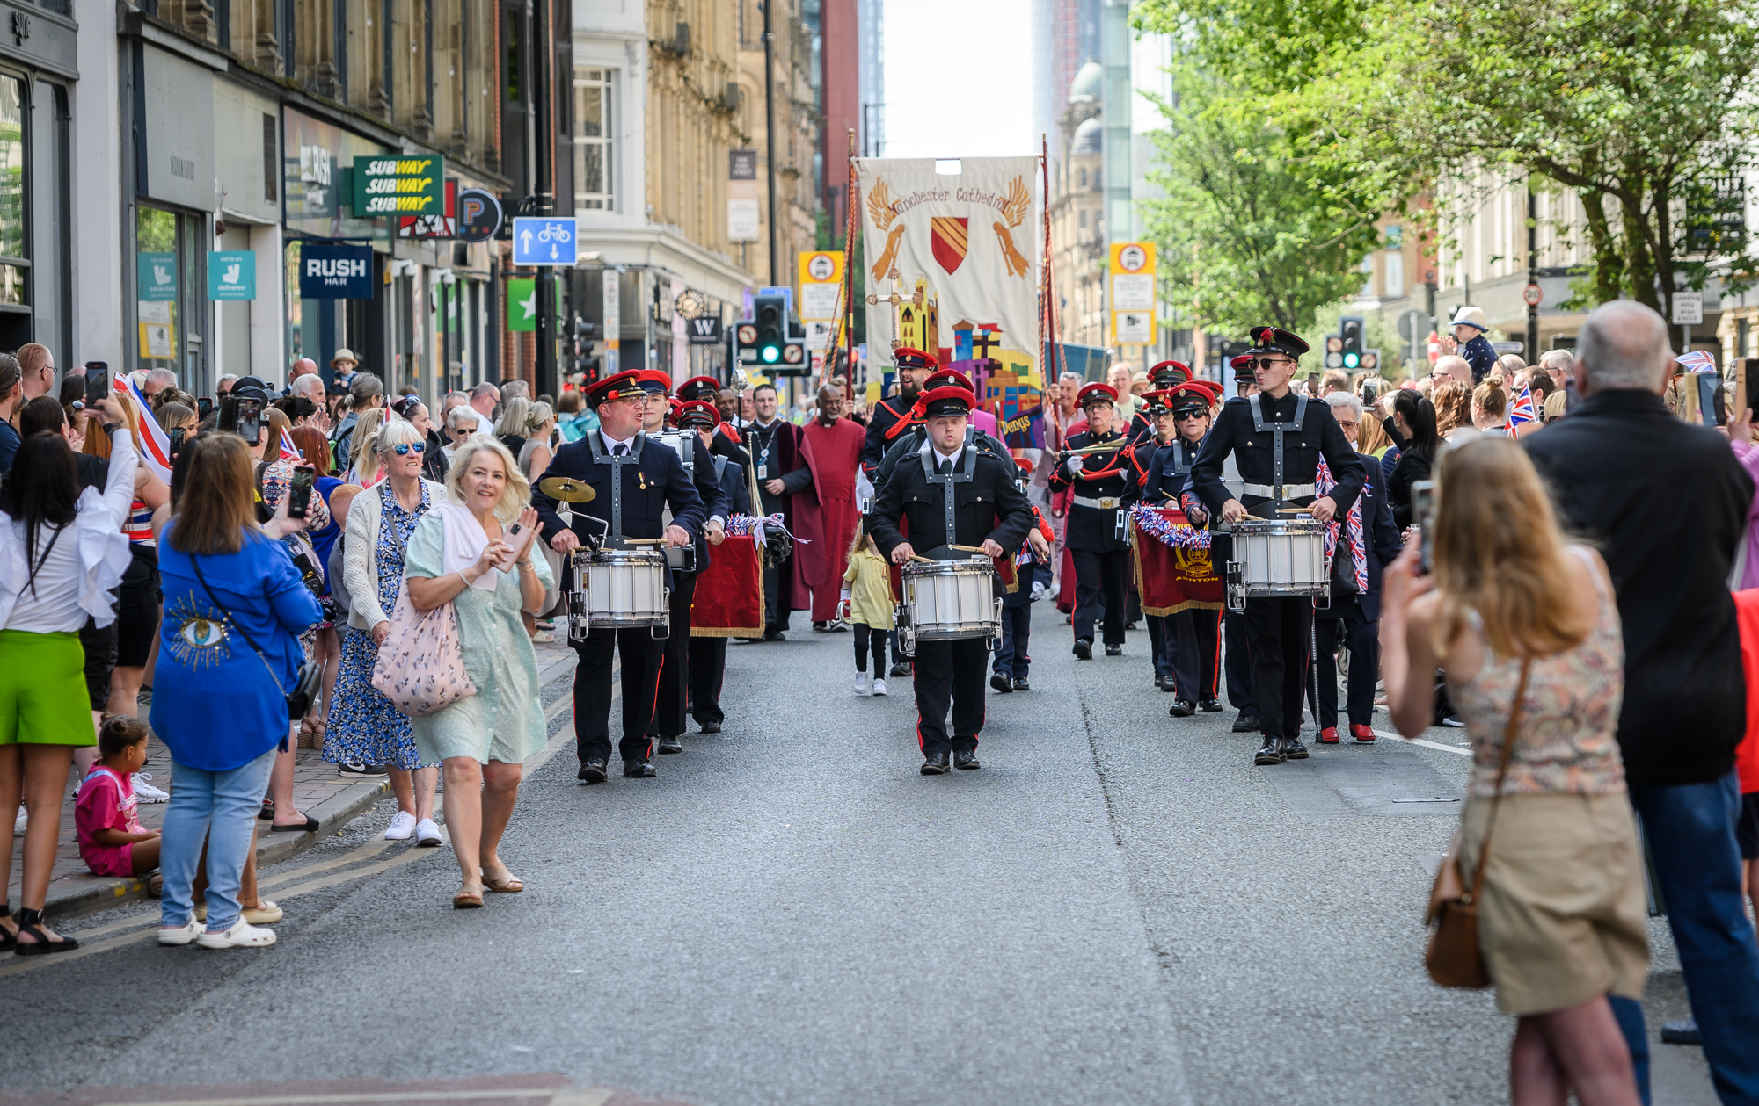
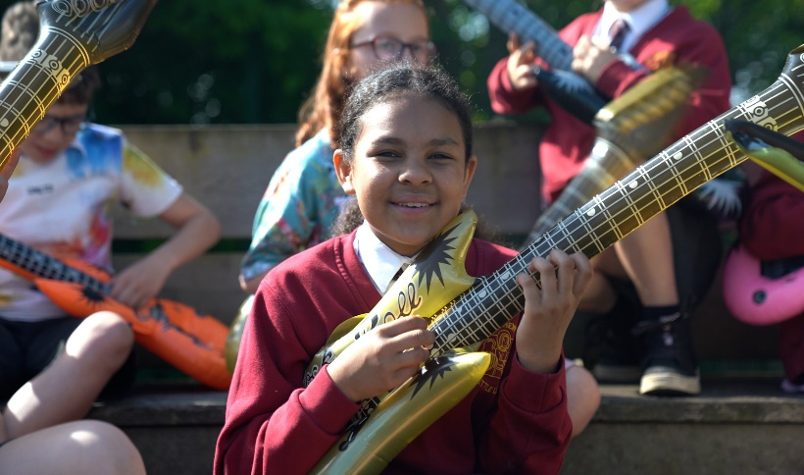
Our Transformation Programme – 2023 - 2030
Bring together the skills and talents of ordained and lay leaders in mission communities
Support clergy and laity wellbeing
Ensure clergy deployment aligns with priorities of parishes and mission communities
Actively promote racial justice, diversity and inclusion
Support our parishes with generosity and thankfulness
Work with parishes to restore the payment of Parish Share
Support our most fragile churches in planning for the future, including revitalisation and closure
Actively manage our investment and property assets for income and capital growth
Promote digital communications and develop social media skills
Support our parishes in providing a safe church environment for all by promoting effective safeguarding
Title 2
The guideline font is size 24 to make it easy to read on a screen
Title 3

Slide 13
Thank you for all of your support, commitment and contributions to achieving our vision and mission goals and for your involvement to come.

