Slide 1
Eco Stepping Stones Workbook
Your digital guide to Eco Stepping Stones, what it is how it works and how you can apply it in your context. V1.
Dr Matthew Barber-Rowell
Eco-Transformation Officer

Slide 2
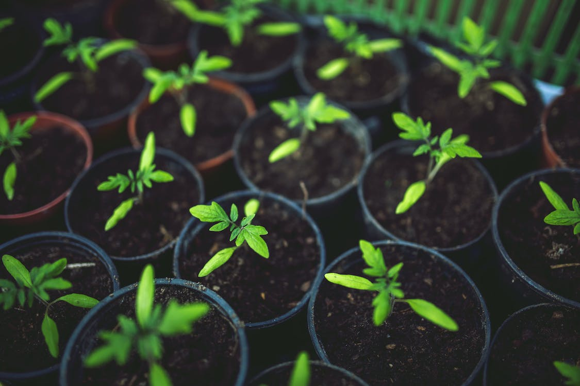

Slide 3
Eco Stepping Stones - An Introduction

Slide 4
Before we begin…
Do you recognise that the Global Climate Crisis is taking place?
Do you know that we have a collective mandate to respond?
Do you agree that we have an individual responsibility to act?
Can you see that God’s call to seek the Kingdom of God is in lock step with a clear response to the Climate Crisis?
Can you see that each small thing we do can make a big difference?
Are you looking for different and creative ways to take your first step, or even your next step?
If you answer YES to any of these questions, welcome to the Eco Stepping Stones journey. We have an exciting road ahead…

Slide 5
“The kingdom of heaven is like a mustard seed, which [they] took and planted in [their] field. Though it is the smallest of seeds, yet when it grows, it is the largest of garden plants and becomes a tree, so that the birds can come and perch in its branches”
Matthew: Chapter 13, verses 31-32

Slide 6
The Workbook
What you can expect from the pages ahead…
This workbook is one of two parts to Eco Stepping Stones. The second part is a set of three videos that you can watch. Together they will guide you through Eco Stepping Stones. This workbook should serve as a step by step guide to the resource and will guide you through the videos when the time comes. This workbook includes a wide variety of things that you can use or not, to help you, whether you are a participant or leader for the course. There is a contents list on page 8 that covers all the sections.
Section 1 is called Hope for the Future and it begins with the basics, addressing why we need Eco Stepping Stones. We address the climate crisis, our mandate to respond, and the theological case for individual and collective action.
There is a long list of people who have helped to make Eco Stepping Stones possible. There are contributions from lay leaders, ordained leaders, parishes, mission communities and deaneries from across the Diocese of Manchester. They are introduced in Section 2. We have captured the diversity of our Diocese and we have tried to share something of that through the stories we have included. In Section 3, we introduce the Eco Stepping Stones resource, with some details about how it relates to your context.

Slide 7
The Workbook
What you can expect from the pages ahead…
In Section 4, it is over to you, where we set out notes on Running the Eco Stepping Stones Course. We turn to the three sessions on offer as part of Eco Stepping Stones so that you can move through them step by step and explore how you might produce good fruit.
In Section 5 we have included a bit of course theory for those who want it, alongside Section 6 with some course coaching tips for leading others through the sessions as well. The idea is to make this all as accessible as possible, but just in case, Section 7 provides a jargon buster in the back of this workbook.
This workbook does not claim to be a comprehensive guide to anything. But it can be a place to start, a guide to the course itself, and an inspiration for producing good fruit, together.

Slide 8
Contents
An at a glance guide…
Hope for the Future
People who have made this possible
What is Eco Stepping Stones and how will it benefit you?
Running the Eco Stepping Stones Course.
Course Theory
Course Coaching
Jargon Buster

Slide 9
This image shows the trend in global temperatures from 1850, to present. This represents a 1.2 degree global temperature rise. It might not sound like much, but we need to stop it before it gets to 1.5 degrees, and really do not want it to go above 2 degrees. This is an image produced by Climatologist Prof Ed Hawkins. Prof Hawkins is a global expert in communicating rigorous science to non-scientists. He also lets us share this image for free via Creative Commons Licence.

Slide 10
1) Hope for the Future

Slide 11
The Global Challenge
Why do we need Eco Stepping Stones now?
Some Science:
Human activities, principally through emissions of greenhouse gases, have unequivocally caused global warming. Temperatures have risen faster since 1970 than in any other 50-year period over the last 2,000 years. In 2020, global surface temperature reached 1.1°C above 1850 levels. It is likely that warming will exceed 1.5°C during the 21st century and make it harder to limit warming below 2°C. Human-caused or 'anthropocentric' climate change is already affecting many weather and climate extremes in every region across the globe. Whilst these temperature increases seem small, they make a big difference to the global environment we live in. Vulnerable communities who have historically contributed the least to climate change are disproportionately and negatively affected. We need to act, beginning with our own small actions that can make a big difference.

Slide 12
A mandate to act
Why do we need Eco Stepping Stones now?
Church of England Response:
In February 2020, a motion was passed by General Synod, the Governing Body for the Church of England, declaring a climate emergency. This motion challenged every Diocese to consider their response. In March 2021, the Diocese of Manchester declared a climate emergency, encouraging people, parishes, chaplaincies and other ministries to integrate Creation Care into their liturgy, worship and teaching. This is part of a plan to achieve year-on-year reductions in emissions and achieve the key target of “net zero” CO2 emissions by 2030. This requires a response to the technical challenges of responding to the climate crisis, such as mapping and reducing our Carbon Footprint. It also means a response to the prophetic challenge, which concentrates on how we live! This all starts with one simple step, and then another and then another. So, through the Eco Stepping Stones resource, we want to encourage all Christians to consider their individual responsibilities and how they may change and engage in actions that safeguard the integrity of creation.

Slide 13
Hope for the future
Why do we need Eco Stepping Stones now?
What the Bible says:
The Bible describes God and our world as perfect and beautiful (Genesis 1) and the way “the fall” causes its moral pollution (Genesis 3). But its concluding paragraphs describe an earth that is new, clean and without pain or death (Gen 21:1–6). God wants us to see all Christian endeavour through the lens of hope. This means being aware of and realistic about now, but also confident about what can come. Through faith in God, we can find such confidence, and this can enable us to work together for a new earth.
Our Theology can help us to explore the will of God and to respond and in turn, our response can inform how we develop our theology. Responding to God is often labelled missio Dei, which can be loosely translated ‘the mission of God’. One of the key themes in Jesus’ teaching was the Kingdom of God which represents one of the principal end-goals of discipleship, because Jesus taught his followers to seek the Kingdom and pray for its fulfilment. Much recent thought therefore explores the links between missio Dei and those that work to improve the world. The fifth ‘Mark of Mission’ makes this link explicit: ‘to strive to safeguard the integrity of creation and sustain and renew the life of the earth.’
At the core of Jesus’ teaching are the New Commandment, to ‘Love one another as I have loved you’ (John 13:33–35) and the Great Commandment, ‘Love the Lord your God ... love your neighbour as yourself’ (Matthew 22:37–39 and Luke 10:27). They come from God and have the same force as the better-known Ten Commandments. Jesus directs us to love all in a sacrificial way (Matthew 25:40). God’s command to love calls us not only to support those impacted most by climate change but address its causes too. In doing so, we will embody hope for the future, step by step. In Matthew chapter 7 verses 16 and 20, Jesus challenges us by saying ‘by their fruits you will know them’. This is a clear sign that what we do, counts.

Slide 14
Taking the first step
Why do we need Eco Stepping Stones now?
The science is unequivocal: Climate change endangers the well-being of people and the planet. Delayed action risks triggering impacts of climate change so catastrophic our world will become unrecognisable.
Our commitment as a church is clear: Through the declaration of a Climate Emergency, the Diocese of Manchester has committed to tackle Net Zero by 2030, and that includes everything we do across the life of our churches.
Christ has called us: The bible sets out our relationship with God, and all that he has created. Joining in with God’s mission is a diverse commitment which includes ‘to strive to safeguard the integrity of creation, and sustain and renew the life of the earth.’. Jesus calls us to love one another, which is both responding to the cries of those who are suffering and addressing the root causes of that suffering too.
The first step: Eco Stepping Stones is available in full and for free, to support you and those you are living, working and journeying with on the road to Net Zero. This resource will enrich you and your understanding of how to respond to the climate crisis and will resource you to support others on the journey to Net Zero too.
The journey begins here…

Slide 15
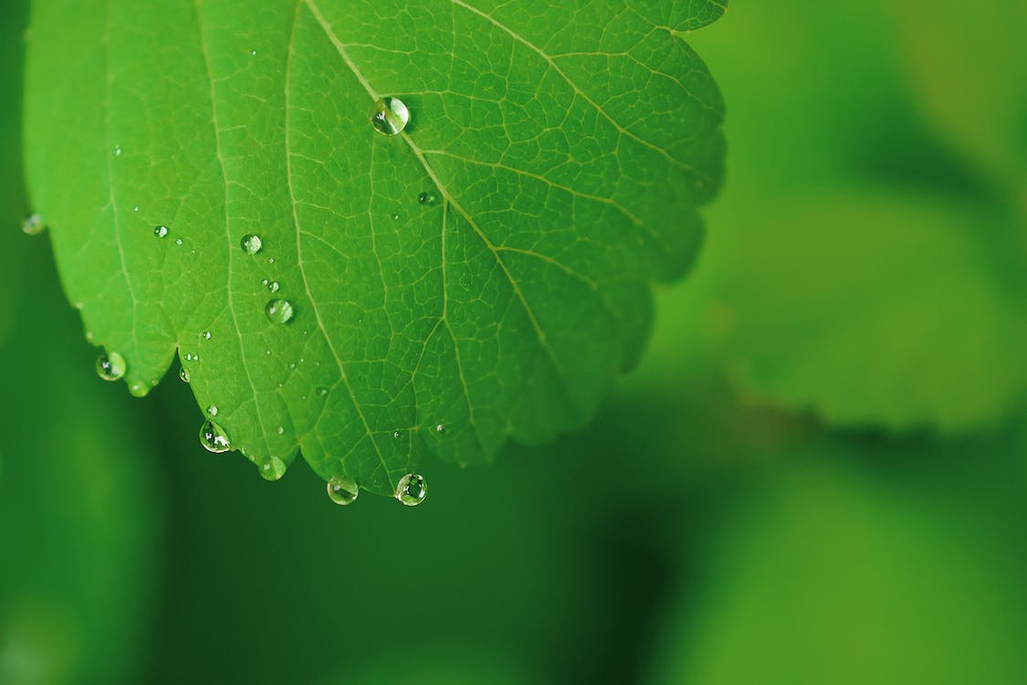

Slide 16
2) People who have made this possible

Slide 17
The contributions that have made Eco Stepping Stones possible
Eco Stepping Stones could not have been made without a wide variety of people. This has meant that there are a wide variety of different stories shared. This has also meant that there are locations from across the Diocese of Manchester on show.
There is also a very important point that has been modelled through the production of Eco Stepping Stones. If we work together, sharing each from what we have to offer, we can make something which is far greater than our individual parts.
Before Eco Stepping Stones is discussed in detail, consider the contributions that people have made to making it at all, and the hope that it represents for our shared future, combatting the climate crisis and seeking the Kingdom of God.

Slide 18
People who have made this possible
The people who made this resource possible, through their small actions that made a big difference
To, Pauline, Lee, Nadine, Matt, Paul M, Karen S, Paul H, Grace, Alison, James, Mike, Kim, Daniel, David, Karen L, Keith, Lovely, Nick, Susan, Kath, Emma and John
Thank you for your words, your insights, your time and all you have brought to Eco Stepping Stones.

Slide 19
The Spaces and Places that have made Eco Stepping Stones possible
A great many spaces and places have been opened to us, to film, to share the beauty of creation, and to bring hope
To St John’s Church Wingate, St Barnabus Church in East Oldham, Christ Church Friezland and the wider Mission Community, the WOW Project, Holy Family Failsworth, and Oldham’s Church in Bolton Deanery part of the Antioch Network.
Thank you for opening your doors, your space and your projects to our questions and our cameras and the chance to share your stories in a way that might inspire others, and everything else that you have brought to Eco Stepping Stones.

Slide 20
There are numerous Teams that have made Eco Stepping Stones possible too
The Teams who made this resource possible, through turning up, bringing insights and being committed in often unseen but highly effective ways
The 2023 Eco Elective Cohort, the Eco Champions Network, the Strategy Team including the Transformation Team and the GNS Team, the Communications Team, and the Environmental Working Group, thank you for your commitment, collegiality, walking the road with us all, holding space for others, and the wider work you do,
Thank you for all you have brought to Eco Stepping Stones.

Slide 21
There are external initiatives that have also made Eco Stepping Stones possible
Those who have contributed through related initiatives such that their small actions could make a big difference
Curating Spaces of Hope, Dream Space Creative, and all those involved in Eco Projects across the Diocese, including Energy Footprint Tool and Eco Church, and Fair Trade.
Thank you for your resource, your pioneering work, your commitment to your respective initiatives and your openness to being included in this resource and all you have brought to Eco Stepping Stones, such that we might resource and support others.

Slide 22
“We see our response to the ecological crisis as a non-negotiable. We recognise that our actions can affect people in our parishes, diocese, nation and around the world. We are supporting our friends and colleagues from across different faiths and none, to deliver a just transition through our mission, and we invite you to join us, through the Eco Stepping Stones Course.”
Bishop of Manchester, Rt Rev Prof David Walker

Slide 23
3) What is Eco Stepping Stones and how will it benefit you?

Slide 24
“Most people already know about and acknowledge [climate change]. Insisting on it is like kicking on an open door. It is time to move on from talking talking talking. Let’s instead use that energy to solve the problem by taking action: action driven not by fear and urgency but by data and cool headed analysis.”
Prof Hans Rosling, Professor of International Health, Founder of the Gapminder Foundation and co-author of Factfulness.

Slide 25
What is eco stepping stones?
A three-part series which supports you to grow, nurture and serve across our churches and mission communities.
A way of sharing stories with one another about our experiences, what works for us, what doesn’t and how that might inspire us to do things together and change things for the better.
Eco Stepping Stones is about, not only the clear evidence for the things we know to be true and that give us hope, but it is about going beyond that evidence and living it out by committing to action in a hopeful way.

Slide 26
What can eco stepping stones help you to do?
Integrate the eco agenda across our mission and combine all three strands of our strategy to grow, nurture and serve
Catalyse growth through eco mission, in conjunction with other eco resources, including the energy footprint tool (EFT), eco-church, the eco elective training course and the (new) eco champion's network
Think differently about your parish finances. The eco resources on offer help to develop your local story, provide evidence for the need for changes, and can contribute for green fundraising.

Slide 27
What can eco stepping stones help you to do?
4) Build confidence, so that anyone can contribute! Eco stepping stones is based on what is already being done, highlighting the wide array of things that count as mission and shows that anyone and everyone can contribute.
5) Connect with others beyond your parish. Eco stepping stones is made for in person, hybrid and online use. It can be used with anyone anywhere. So, this can help us broaden our mission beyond our parish.

Slide 28
What can eco stepping stones help you to do?
6) Move forward along the road to net zero by 2030. We don’t always need to keep the end in mind whilst we are engaging in mission. It is right to be focussed on what is in front of us and to leave the big think or long-term strategy for others. But rest assured, if you want to explore the Net Zero agenda, Eco Stepping Stones links well with it, and you the steps we take through it can move us onward down a practical path to reach Net Zero
7) Finally, the resource is made to shed light on, and raise awareness of things that are going on outside of our contexts, things that we may not have ever considered, expressed through stories that not only make the change possible, but can inspire us to act. Connecting with people and places that we’ve not encountered before, something that the eco team in the diocese are here and willing to facilitate, can make the world of difference to our mission communities, deanery, diocese and the region that we are in and the mission of God that we share

Slide 29
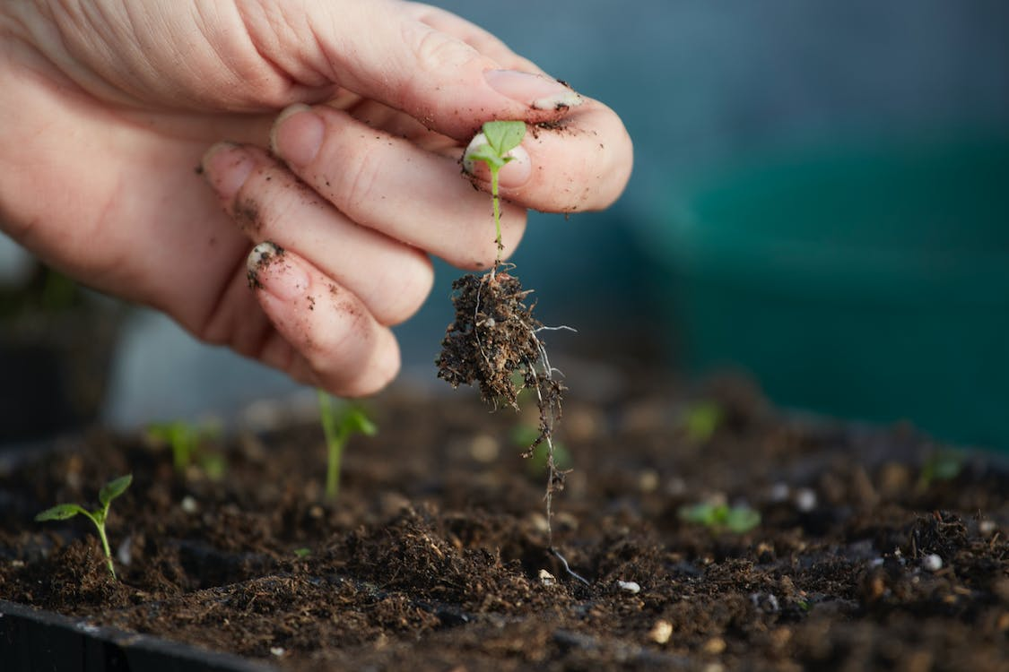

Slide 30
4) The Sessions
The questions, and a guide on how and where to answer them

Slide 31
The questions, how and where to answer them
Eco Stepping Stones is a digital resource, that can be used at online or in person gatherings. The slides in this section relate to the delivery of Eco Stepping Stones and should be read in conjunction with the video resources.
These slides set out, in order, the sessions, the questions you will be asked, and offer space for recording your answers. It is possible to record answers using a paper and a pen, or maybe even post-its and flipchart paper, as part of a facilitated conversation.

Slide 32
Session One:

Slide 33
Initial thought…
Why should I think about Eco Stuff? Take a minute or two to reflect on these. Consider which if any relate to you.
People on the other side of the world are suffering
If I do not act then the planet will be ruined for future generations
Nature is beautiful and we should keep it like that
God created the world.
If our environment is healthy, then so are we
Scripture gives us a clear mandate to care for creation
This is my mission field
If I don’t engage with this, how can I look my grandchildren in the eye?
I am part of creation.
Engaging in eco mission is a non-negotiable
Ecological considerations relate to everywhere and everything in our lives
By considering eco mission, we are opening up new ways of thinking about our parish and mission community life
Caring for creation is a witness to my family and friends who do not attend church
I am passionate about looking after the environment, from the plants in my garden to the wildlife in our local parks, to the climate systems that shape our planet
We have a mandate to respond to the climate crises in our parishes, mission communities, Deanery and Diocese!

Slide 34
Questions
These are the questions from each episode. Use the space on the page to jot down your answers.
Q1 What did the seeds that were planted look like? We know they weren’t mustard seeds.
Q2 How did the seeds that were planted take root and begin to grow?

Slide 35
Questions
These are the questions from each episode. Use the space on the page to jot down your answers.
Q3 How does this story relate to your context? Think about the seeds that are planted and the way they begin to grow.
Q4 What did the seeds that were planted look like? We know they weren’t mustard seeds.

Slide 36
Questions
These are the questions from each episode. Use the space on the page to jot down your answers.
Q5 How did the seeds that were planted take root and begin to grow?
Q6 How does this story relate to your context? Think about the seeds that are planted and the way they begin to grow.

Slide 37
Session Two

Slide 38
Questions
These are the questions from each episode. Use the space on the page to jot down your answers.
Q7) Who are you?
Q8) How do you know?
Q9) What do you enjoy doing?

Slide 39
Questions
These are the questions from each episode. Use the space on the page to jot down your answers.
Q10) What do you notice about this use of space?
Q11) What opportunities for discipleship does this kind of space offer?

Slide 40
Questions
These are the questions from each episode. Use the space on the page to jot down your answers.
Q12 How does this story relate to your context? Think about it in terms of how you open up spaces in which discipleship can take place.
Q13 What do you notice about this use of space?

Slide 41
Questions
These are the questions from each episode. Use the space on the page to jot down your answers.
Q14 What opportunities for discipleship does this kind of space offer?
Q15 How does this story relate to your context? Think about it in terms of how you open up spaces in which discipleship can take place

Slide 42
Session Three

Slide 43
Can I really do this?
What skills and experience are relevant to eco mission?
Having a conversation
Caring about others
Organising a referral
Holding a party
Sorting the admin; emails, schedules etc
Reading up on or researching complex subjects
Being an enthusiastic person
Rallying people to get involved
Simply being aware of the world around you
Having friends or family who live overseas
Working in a sector that is responding to the Net Zero policy (pst… that’s all of them!)
Project management
Fundraising
Being in relationship with God and all that he created (this isn’t a skill, but it is a deeply enriching experience)
This is not an exhaustive list… feel free to add your own

Slide 44
Questions
These are the questions from each episode. Use the space on the page to jot down your answers.
Q16 What were the range of skills and experience on offer?
Q17 What difference do you think this is making in the community it serves?

Slide 45
Questions
These are the questions from each episode. Use the space on the page to jot down your answers.
Q18 How does this story relate to your context?
Q19 What do you notice about the different types of service in this story?

Slide 46
Questions
These are the questions from each episode. Use the space on the page to jot down your answers.
Q20 What opportunities for service by others does this open up?
Q21 How does this story relate to your context? Think about the seeds planted in session one, and the discipleship encouraged in session two. Finally, consider what this means for the service you might engage in.

Slide 47
“The present climate crisis is reminding us that we've not always taken creation care seriously and there is much work for us all to do. We can still make a difference and we must, especially as we journey to Net Zero by 2030. Eco Stepping Stones is a great resource to help us in this…”
Bishop of Bolton, Rt Rev Dr Matthew Porter - Lead Bishop in Diocese of Manchester for Environmental Matters

Slide 48
5) Course Theory
Some of the ideas that underpin Eco Stepping Stones

Slide 49
Eco Stepping Stones
Course theory - Leadership
We are seeking to promote and encourage the formation of lay leadership rooted in everyday activities. We are not trying to tell people what to do, but rather we are seeking to encourage people to be confident in being themselves and bringing that to the things that they do.
There are 5 Principles underpinning the resource and the process we are working through. They are, Freedom, Relationship, Service, Affect and Authenticity. A little more about what is meant by these principles is explained over the page.

Slide 50
Eco Stepping Stones
Course theory - Leadership
Freedom: the potential we have within us and the ability we have to make that real and tangible. Put another way, taking responsibility, and sharing the fullest possible expression of our personality.
Relationship: we are in a relationship with everyone and everything, from the people we love to the places we live, to the rest of the world as we see it. Relationships help us to understand the freedom that we have positively, in terms of freedom for others, as opposed to Freedom from others.
Service: expressing freedom, in relationship with others is service. Simply put, it is the stuff that we do. To serve is to bring ourselves to a task in a way that is for others. We can think of service as incarnation; becoming, through our actions, who we are called to be.
Affect: The principle of affect is a guide to be aware of and sensitive to everything around us. We can have an affect on each other, on our environment and likewise, our environment can have an affect on us. Think about the affect of what we do as we do it.
Authenticity: finally, we should consider if the freedom we are sharing through relationship with others, and expressing through service that is affective and affected by what is around us, fits within a wider story. This is not an inward sense of authenticity that we decide upon for ourselves, but an outward question for others to answer about whether what we are doing is truly hopeful and hope filled.

Slide 51
Eco Stepping Stones
Course theory - Stories
Metaphor - The series is premised on the metaphor of producing good fruit, which Jesus uses in the Sermon on the Mount (Matthew ch7 v16 and v20).
Process - The premise for the metaphor is that the seed is planted, it is nurtured and grown. Jesus opens this up through a variety of ways, which gives theological depth, should people wish to explore it.
Pattern - This is the pattern we are offering in the stories that are shared in the series and that people can develop during the course.
Practice - The seed planted and the fruit that grows are rooted in relationships, the roles and responsibilities we take on, the things that motivate us, the way that we care for creation, the things we give our time to and the partnerships we form.

Slide 52
Eco Stepping Stones
Course theory - Small actions that make a big difference
Plant: The stories we are hearing are deliberately simple and accessible. What we are talking about is not complicated. At the very least people can copy what they hear, but the purpose here is to inspire action in our own contexts.
Nurture: The idea is to encourage participants to focus on things they can do, not things they can’t or that feel too big or too much. Everything counts.
Grow: The stories we are sharing are not finished. These stories are continuing on and growing. This leaves space for us to imagine what might come next, and what things might look like in our context.

Slide 53
“The approach to leadership we are using has been grown locally and sourced from diverse communities in the north west of England. You are joining over nearly 1500 people who have already helped to coproduce this approach and are committed to seeking hope for the future, by letting their small actions make a big difference”
Dr Matthew Barber-Rowell, Founder of Curating Spaces of Hope

Slide 54
6) Course Coaching
A basic guide through the Eco Stepping Stones Process

Slide 55
Eco Stepping Stones
Course Coaching - Shared Behaviours
Vulnerability - we are asking people to consider their own context, and what it is that they bring to it. This is potentially a vulnerable thing to do. This is something that will reward us, if we embrace it in the context of the course, but nonetheless, it is a brave thing to do.
Respect - related to this sense of vulnerability being brave, is a need for respect for others and what we each bring to the conversation. Respect does not mean agree with, but it is a foundation upon which good conversations will take place.
Connection - this takes two forms. The first is that by gathering to complete the course, we are able to connect with people we do not necessarily know, but with whom we know we have something in common. The second is that the ideas and concepts that emerge during our conversation might have surprising connections to one another. With both understandings of connection, I want to encourage you to take your time and to enjoy the process, without rushing to conclusions.

Slide 56
Eco Stepping Stones
Course Coaching – Practice
Intention: Every voice should be heard. The practice within the sessions should be one of recording our own views first and sharing together second. So we know that first and foremost our view counts. Then everyone should then be given space to speak about what matters to them in a way that is suitable for the individuals and the group
Attention: Let the conversations flow and let details emerge. Give attention to those details, and let people reflect on them. There will be more to find in the resource as more people engage and look at it differently.
Ascension: Let the conversation go beyond the study itself. The purpose is to bring all we feel is relevant to our eco mission and can relate to our parishes, mission communities, deaneries and diocese. In this way, encourage ascension out of our immediate context, mobilising one another, rising to the challenge and committing to action.

Slide 57
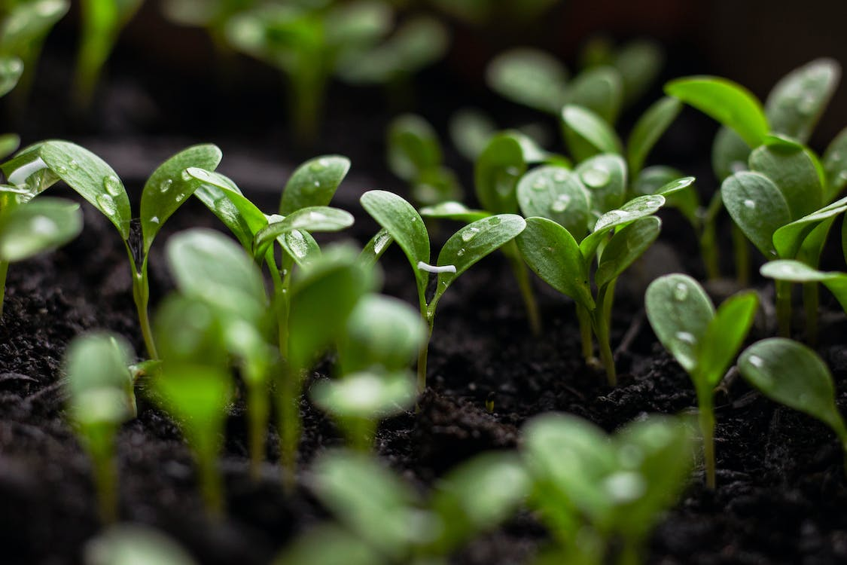

Slide 58
7) Jargon Buster
We have tried to make this resource accessible. Different language can help us with that, but where we have used ‘jargon’, we have explained it here.
Ecology - The study of how organisms interact with their environment and what happens when ecosystems do not function normally.
Ecosystem — A geographic area in which organisms (the people, plants and animals living there) form a bubble of life in tandem with the weather and landscape.
Anthropocene - The Anthropocene is a period in the recorded history of our planet that shows our impact and the damage we are doing, by polluting the earth.
Carbon Dioxide - Carbon combined with oxygen that exists as a gas in the atmosphere and also dissolves readily in the oceans. Gaseous CO2 is one the principal causes of global warming
Carbon footprint — The estimated volume of emissions of greenhouse gases (especially CO2) produced directly or indirectly by an individual, an organisation, or a population.
Net Zero (also Carbon neutral) — The concept that any carbon dioxide released into the atmosphere from an activity is balanced by an equivalent amount being removed.
Climate change / crisis / emergency — Persistent or long-term changes to the weather around the Earth caused by pollution. Examples include increased global temperatures, irregular weather patterns, shrinking polar ice caps, etc. The crisis describes the devastating effects of climate change on populations and the planet, and noting it as an emergency invites urgent action to reduce or halt that climate change.
Rewilding — A conservation strategy that involves the reintroduction of wildlife and species to their original habitats. The goal of rewilding is increasing biodiversity and the restoring natural processes.

Slide 59
“By their Fruits you will know them…”
Matthew: Chapter 7, verses 16 and 20.

Slide 60
In 1971 the average CO2 footprint in the UK peaked at 11.9 metric tonnes per person per year.
In 2018, it was 5.65 metric tonnes per person per year.
It is possible for the small actions we each take, to literally make a big difference.
This data was sourced from the Carbon Dioxide Information Analysis Center and the Gapminder Foundation

Slide 61
Stay in touch
Details about how to share uses of the ESS, and to learn about opportunities to connect with other ESS users…
Please sign up for our Eco-Champions Newsletter by visiting: https://manchester.anglican.org/eco-stepping-stones
Please join us in our Eco-Diocese Facebook page by visiting: https://facebook.com/groups/2007834829476620
Or on our Eco Diocese Twitter: @mandioeco
If you wish to get in touch, please contact comms@manchester.anglican.org

