Slide 1


Our brand
Diocese of Manchester
Revised December 2023

Slide 2
Contents
These brand guidelines have been developed to ensure that our strong, recognisable brand is maintained and used correctly.
If you have any questions, comments or require help, please contact a member of the Communications Team.
03 Colour palette
04 Fonts and typography
05 Logo
06 Our style
07 Templates
08 Using Canva
09 Photography
10 Videography
11 Consent & GDPR
12 E-news and newsletters
13 How to use our Logo
14 Contact us

Slide 3
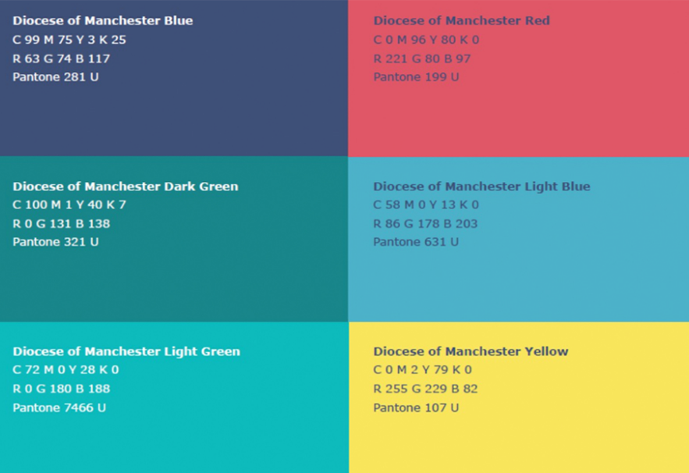
Colour palette
We use a simple colour palette, made up of blues and greens, accented with yellow and red.
-The CMYK values are to be used for printing.
-The RBG values are to be used for digital content creation.

Slide 4
Fonts and typography
We now use Open Sans font for all documentation including reports, presentations, letters , and our website.
Cabin, our secondary font, is occasionally used for headings and titles.
Both fonts are widely available in Microsoft Office applications or can be downloaded for free from fonts.google.com.
Open Sans
A B C D E F G H I J K L M N O P Q R S T U V W X Y Z
a b c d e f g h I j k l m n o p q r s t u v w x y z
Cabin
A B C D E F G H I J K L M N O P Q R S T U V W X Y Z
a b c d e f g h I j k l m n o p q r s t u v w x y z

Slide 5

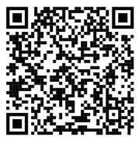
Logo
The Diocese of Manchester Church For A Different World logo should be used as the primary logo for all documents and digital content.
The logo should be located in the top-left or bottom-left of your piece of content.
The logo can be shortened to show the words ‘Church For A Different World’ as this is consistent and reflective of our diocesan branding. Please check with the comms team if you wish to use the logo in this way.
Download our logo in PNG or JPEG by scanning the QR Code and selecting the version you need.
These logos are also available on our shared drive here.

Slide 6
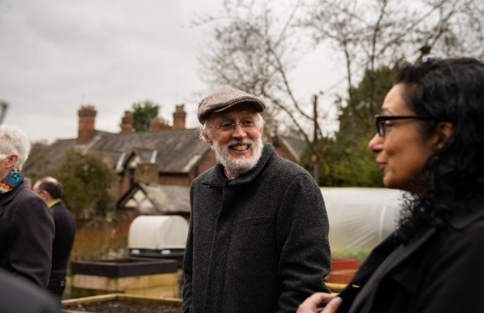
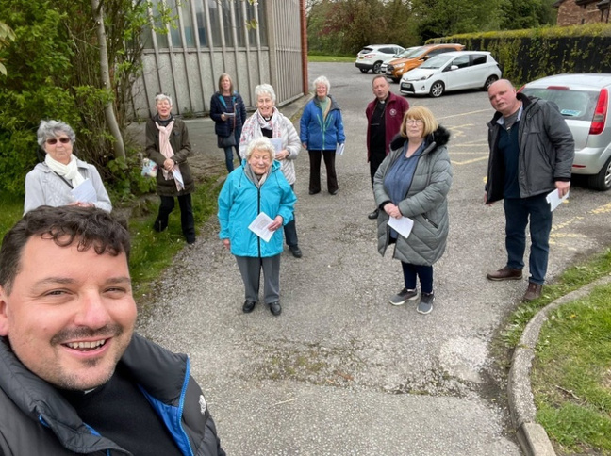
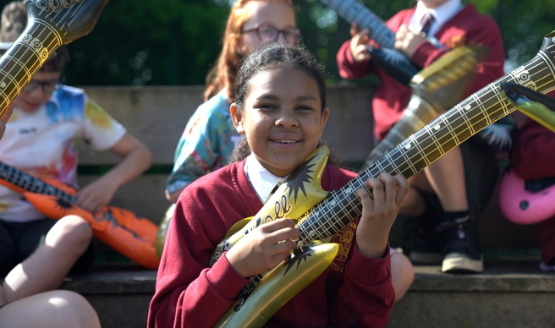
Our style
You may have noticed that we have moved away from dark backgrounds on our templates in a bid to save ink and brighten the look and feel of our brand.
We have also moved away from the use of icons in favour of focussing on photographs of people and places. We feel that this brings our vision and mission goals to life.

Slide 7
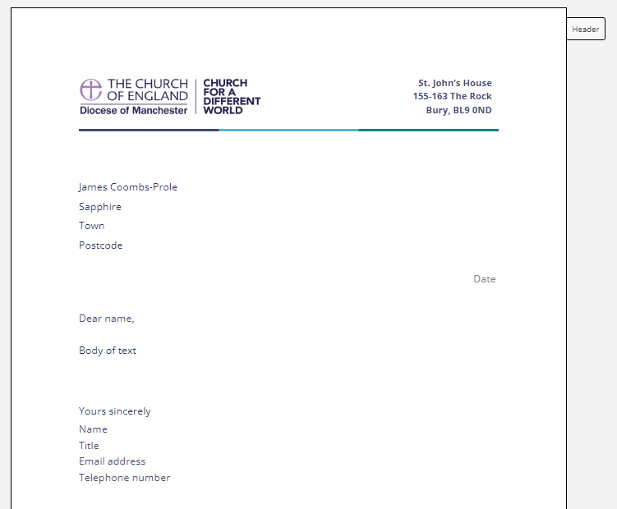
Templates
We have new templates for you to use in order to keep your content on brand. These include:
Presentation
Report
Church Times Advert (please contact the comms team)
Social Media Post
Letterhead
These can be found here on our SharePoint under the /templates/ folder.
For more complex designs such as printed booklets please contact the comms team.

Slide 8
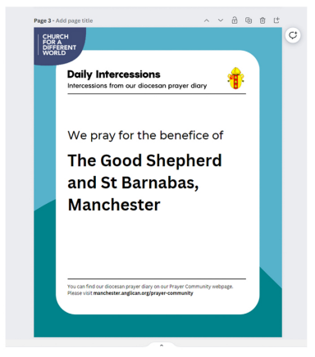
Using Canva
Canva is a free graphic design platform that we should take full advantage of. It can be used to design presentations, social media posts, reports, leaflets, and much more.
If you want to get started with learning Canva, get in touch with the comms team, we have a number of templates that you can use to keep your content on brand.
Visit Canva.com and setup a free account.

Slide 9
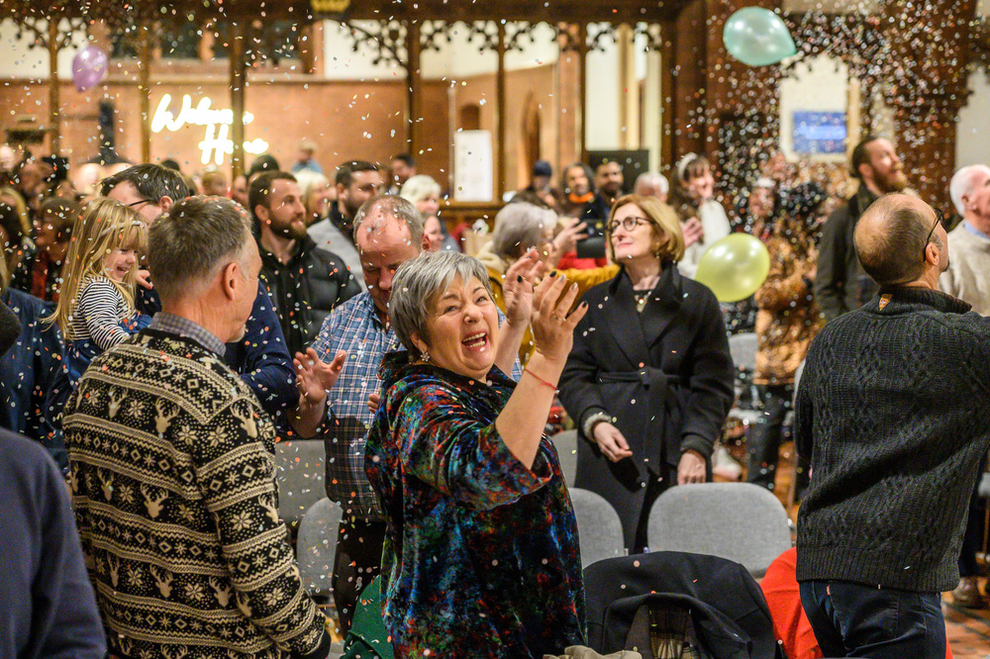
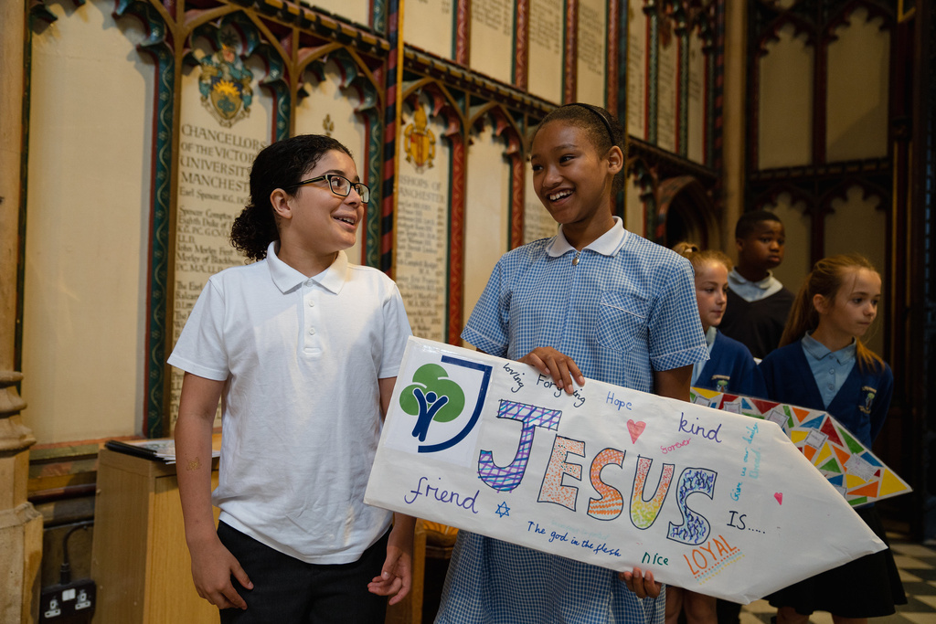
Photography
We have an extensive collection of photos for you to use on our Flickr at www.flickr.com/dioceseofmanchester/
Most modern mobile phones have amazing cameras. Take advantage of them and share your photos with the comms team!
If you are taking your own photos, ensure the content is evenly lit, centralised, and clear.
If you’re hosting an event and want professional support, then let us know.
Please choose photographs that represent the rich diversity of our diocese.

Slide 10
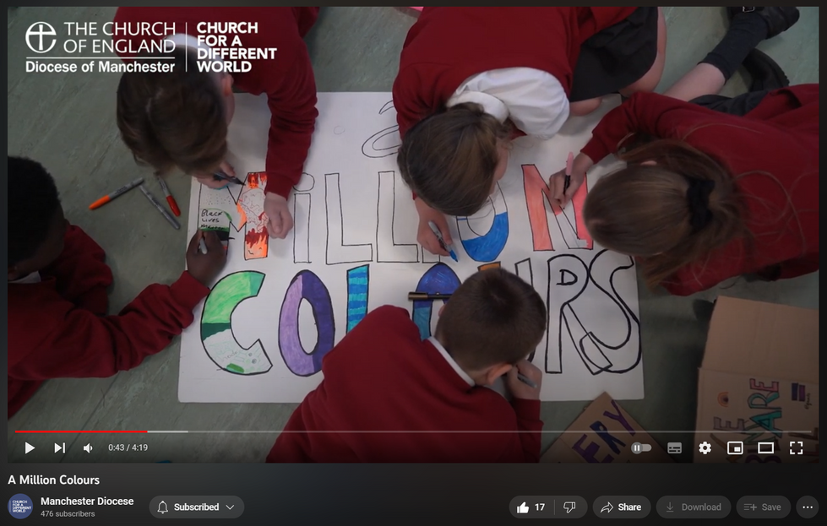
Videography
Video has fast become one of the most effective ways to communicate an engaging message.
If you are looking to share videos online, use a platform like Canva or CapCut and ensure you include the Diocesan logo in the top-left corner.
An excellent guide from the Digital Labs team can help you get started if you’re looking to film yourself. For more professional filming and video projects, please get in touch with the comms team to discuss.
You can view our video catalogue on our YouTube account:
www.youtube.com/@manchesterdiocese

Slide 11

Consent and GDPR
We encourage everyone to engage with content creation and communications, but please be conscious of the need for consent.
Our policy information can be found on our website: www.manchester.anglican.org/gdpr/
Photography consent Form
Church of England photography and GDPR

Slide 12
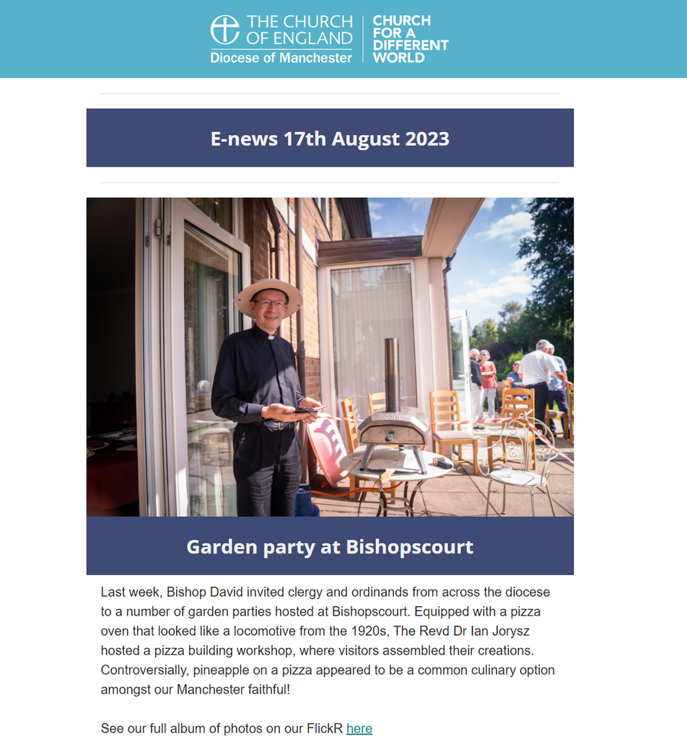
E-news and newsletters
We use MailChimp for our mailing platform in the diocese. We circulate a weekly e-news and staff news to those registered, containing up-to-date information on news and events from across the diocese.
If you wish to have an item placed in our weekly
Thursday e-newsletter, please send your request and any content to the comms team by the end of each Wednesday.
We can also help you to set up an online newsletter on Mailchimp, it’s much easier than formatting on word etc.

Slide 13





How to use our Logo
In the diocese, we have several logo variations. Where possible, we encourage you to use the templates we have provided.
However, if you are designing your own document, please ensure that the logo is placed in the top-left corner and the logo does not have a coloured background when placed on a white canvas.
Please see the example screenshots on the right side of this page. If you have any questions at all about the positioning or design of a document, please get in touch with the comms team.

Slide 14
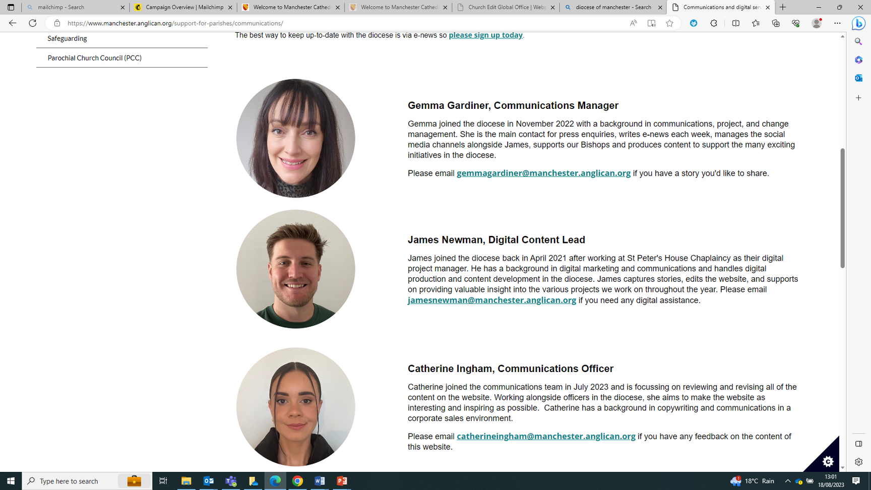
Communications team
For more help and advice, please contact us:
Gemma Gardiner, Communications Manager
07834 224444
gemmagardiner@manchester.anglican.org
James Newman, Digital Content Lead
0161 828 1450
jamesnewman@manchester.anglican.org
Catherine Ingham, Communications Officer
0161 828 1405
catherineingham@manchester.anglican.org

