Slide 1
Our Emerging Strategy
Bury and Rossendale Deanery
Monday, 13th January 2025

Slide 2
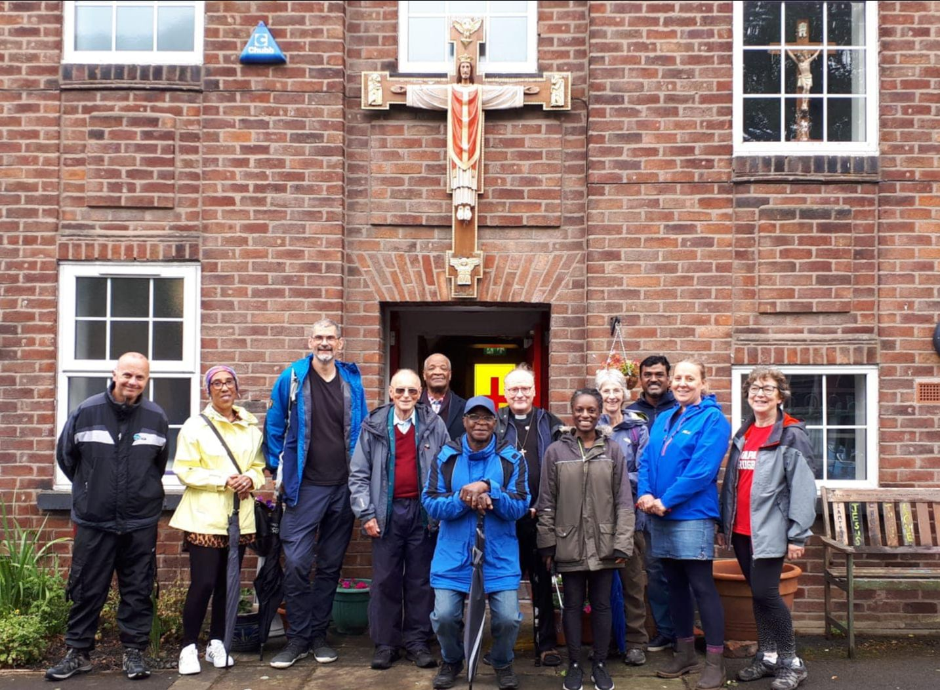
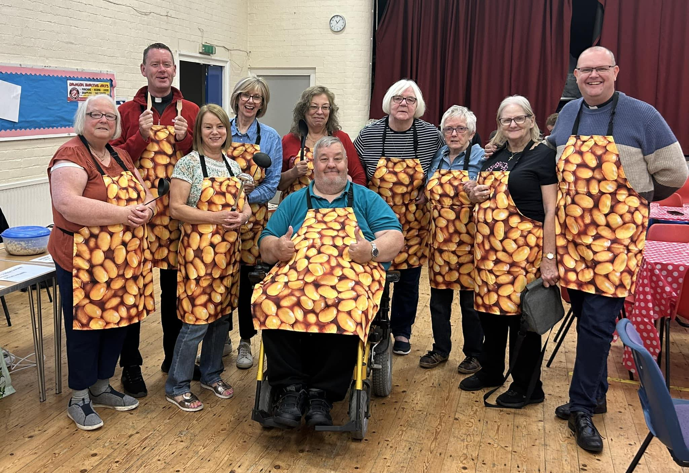
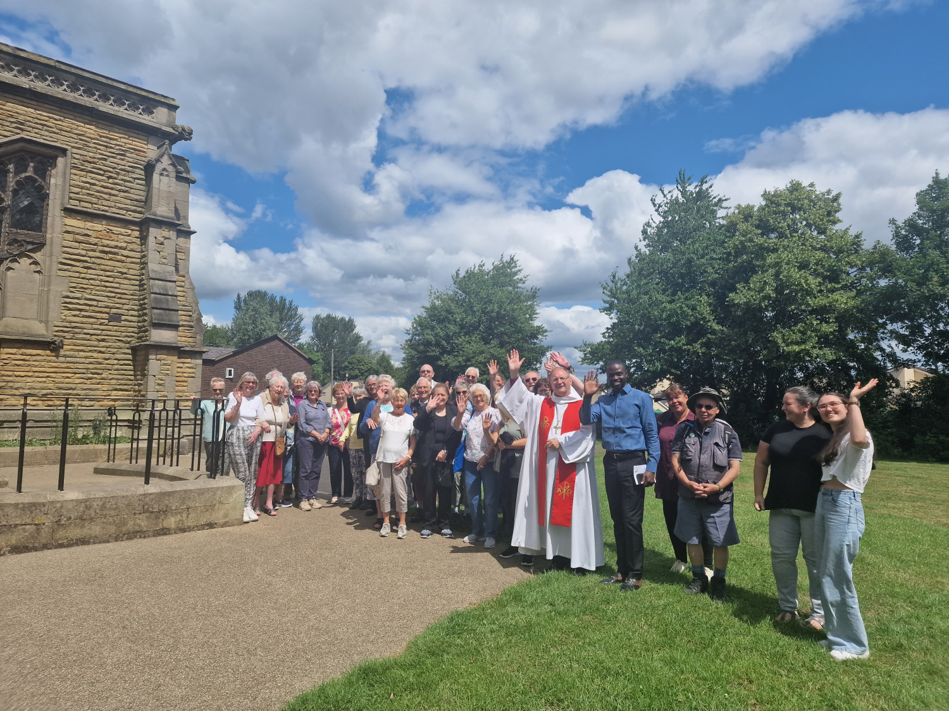
Our Transformation Programme
We have made good progress since getting underway with our Transformation Programme, for which we have been awarded significant funding by the Church Commissioners since 2017.
Many of us have experienced first-hand how things are changing for the better across the diocese in our parishes, schools and chaplaincies.
This is helping us achieve our vision to be a worshipping, growing, transforming Christian presence at the heart of every community.
And work towards our mission goals which are to grow our churches, nurture new and existing disciples, and serve the vulnerable, deprived and excluded.

Slide 3
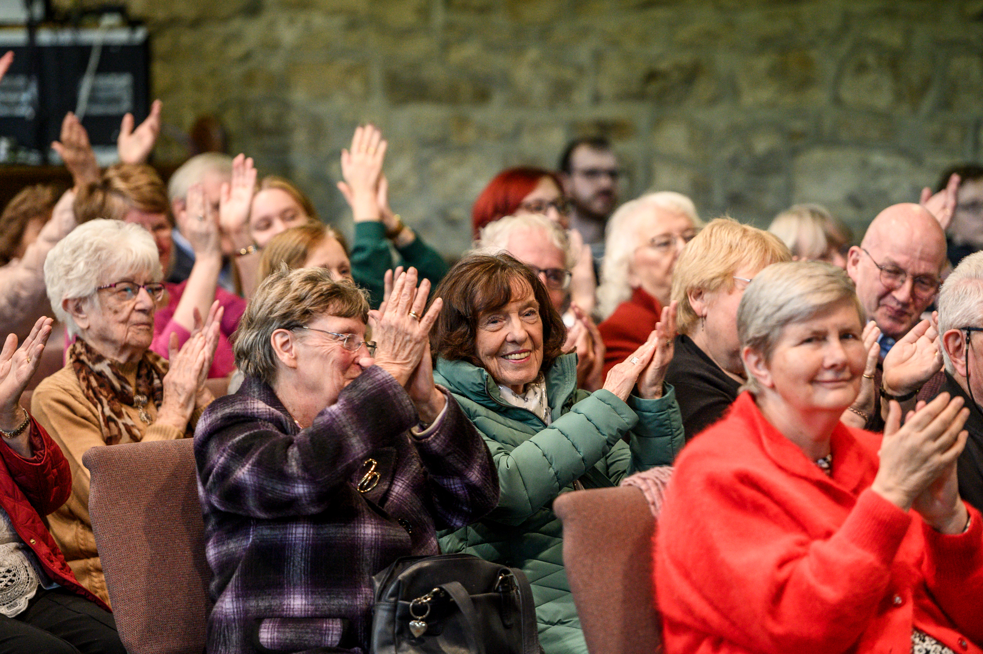
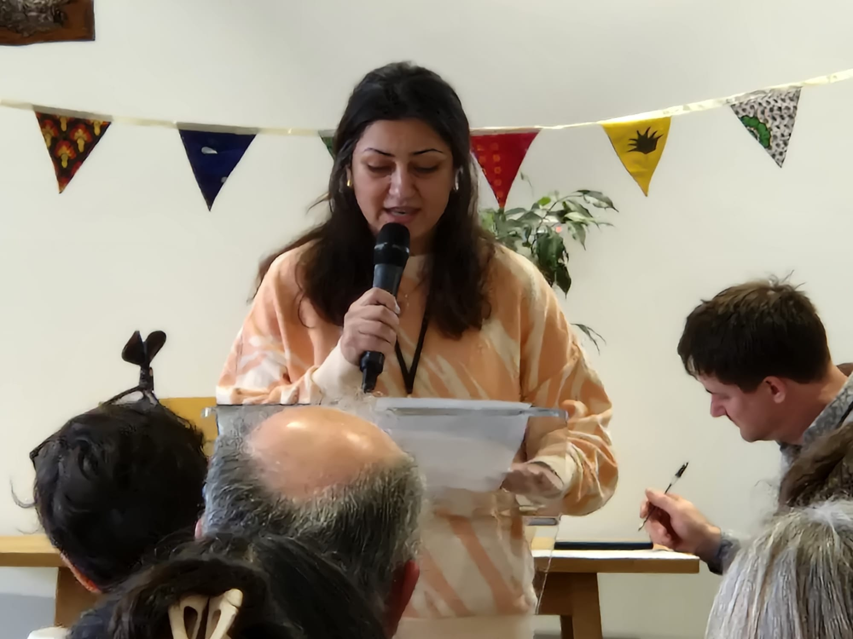
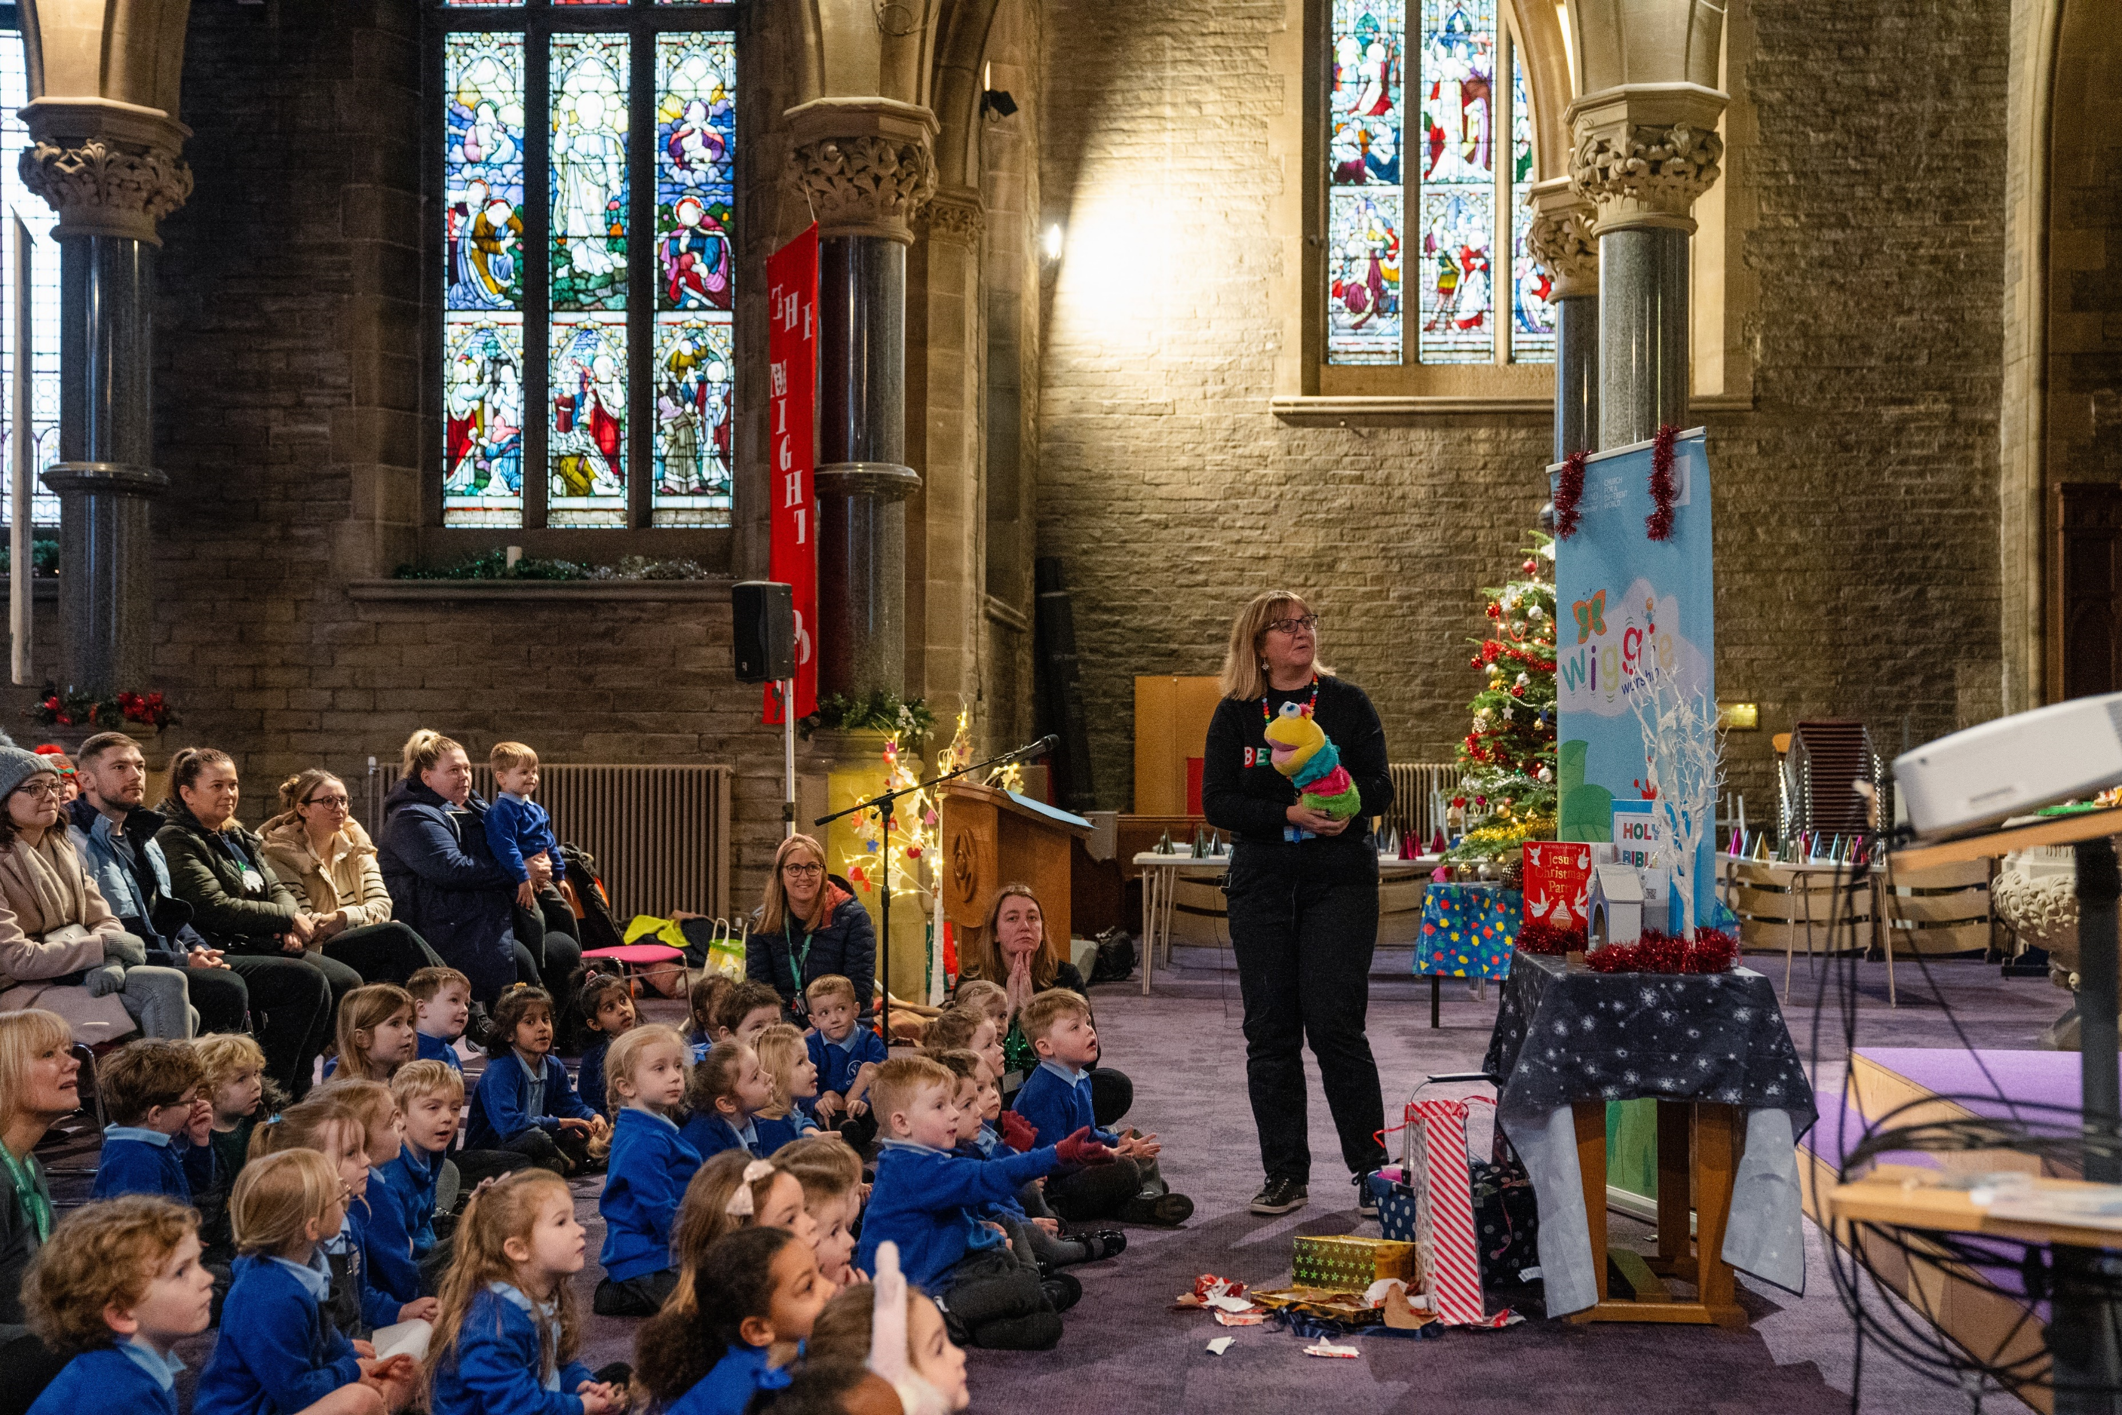
Our Progress
Our achievements include:
moving to our new deanery structures
the creation of our 33 mission communities
investing in our lay leaders
supporting children’s ministry in each deanery
increasing the practical support for parishes
filling clergy vacancies as our curates finish their curacies.
Most of these changes have focused on new ways of working together which are becoming embedded in the life of our diocese.

Slide 4
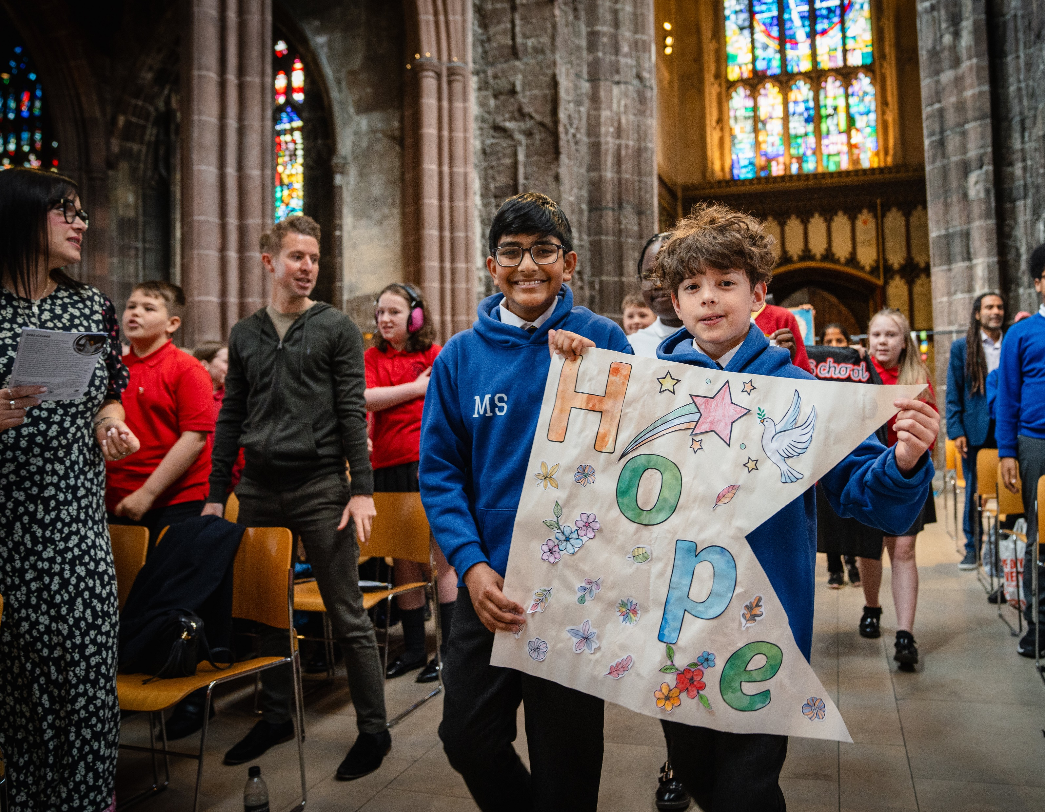
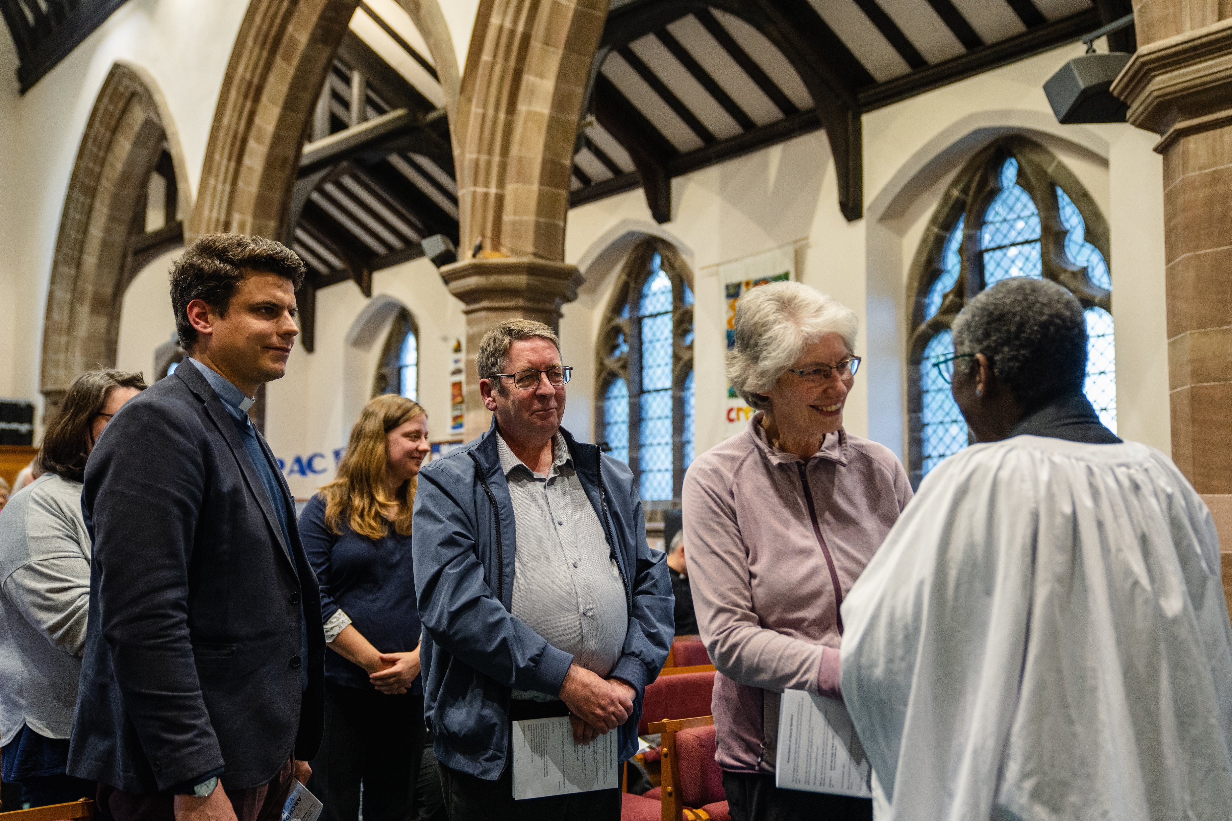
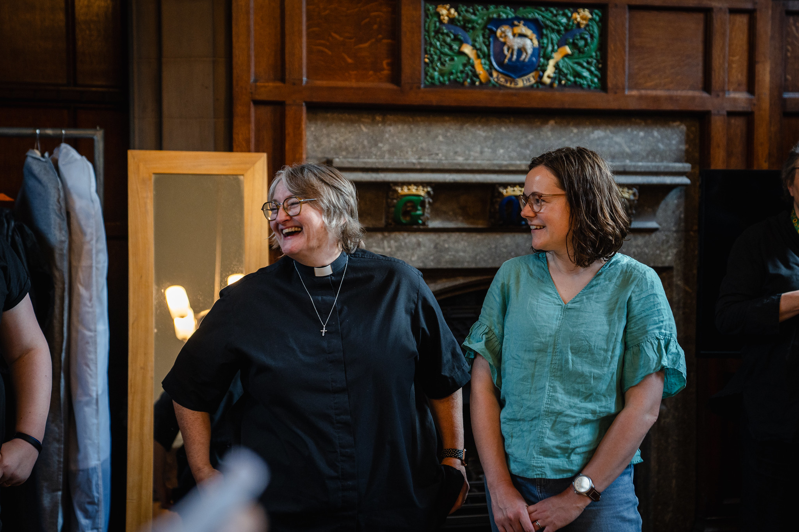
Our Mission Priorities
We are shifting our focus from capacity and structural changes to our key themes of:
Growing Younger
Church Planting and Revitalisation
Developing Missional Leaders
Parish Renewal
Given the excellent start that has been made, we now have the opportunity to be even more creative and ambitious with our plans for the future.
We would like your help in shaping these plans.

Slide 5
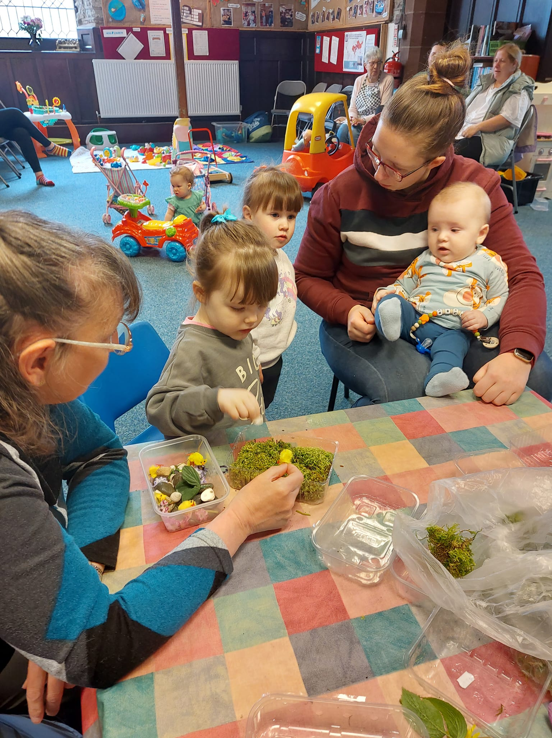
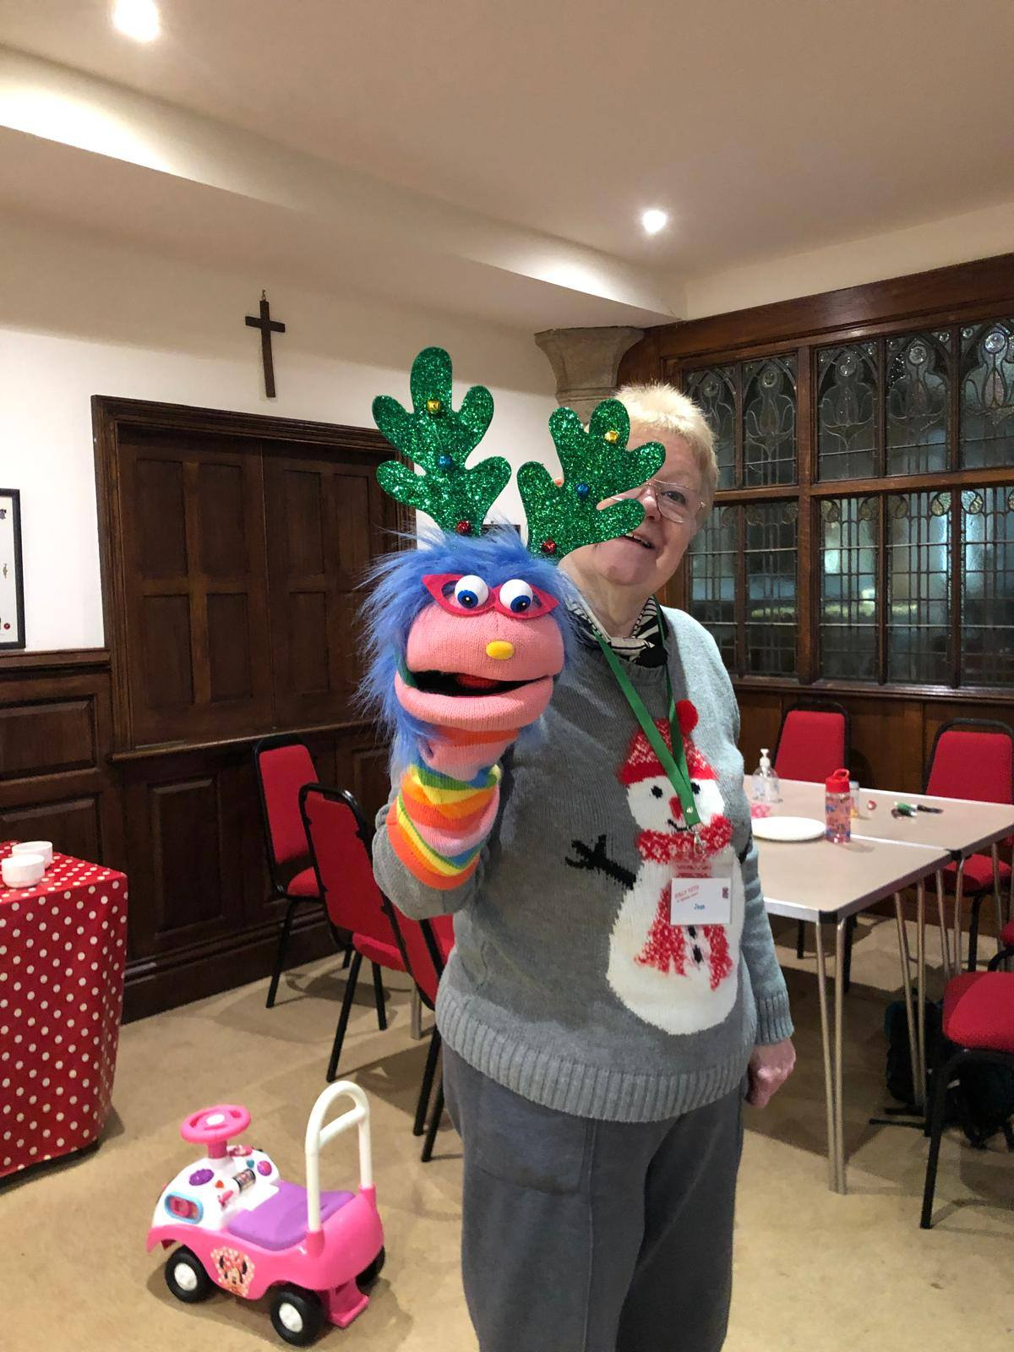
Growing Younger
We have been doing great work in this area, exploring new approaches with the Children Changing Places programme in Bolton, and Man-Dio Growing Faith in the other deaneries.
We are now combining this experience and learning to develop a comprehensive approach to engaging with children, young people, and their families.
Our focus is on strengthening the links between our parishes and our church schools.

Slide 6
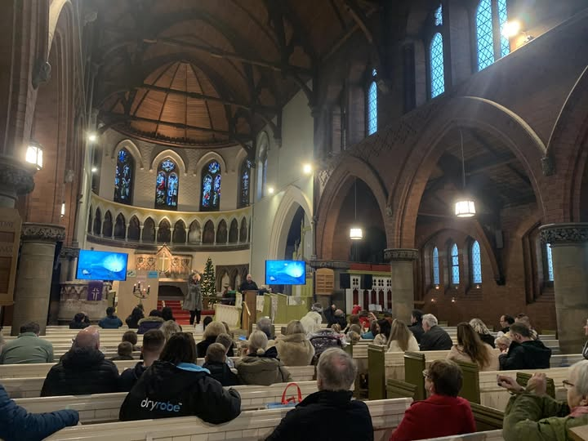
Church Planting and Revitalisation
We have had similar successes with church planting and revitalisation.
Over the last seven years, we have set up four new resource churches and more than ten church plants.
We now want to build on this learning and establish churches carrying a DNA of mission across our diocese, particularly in communities where attendance is low.

Slide 7
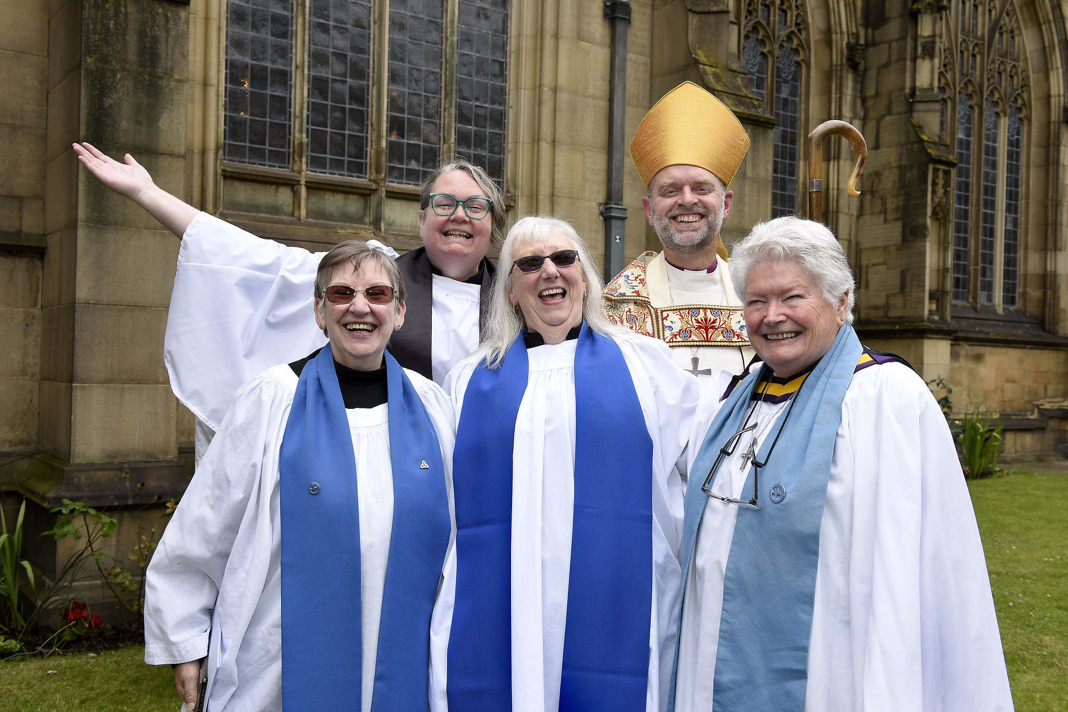
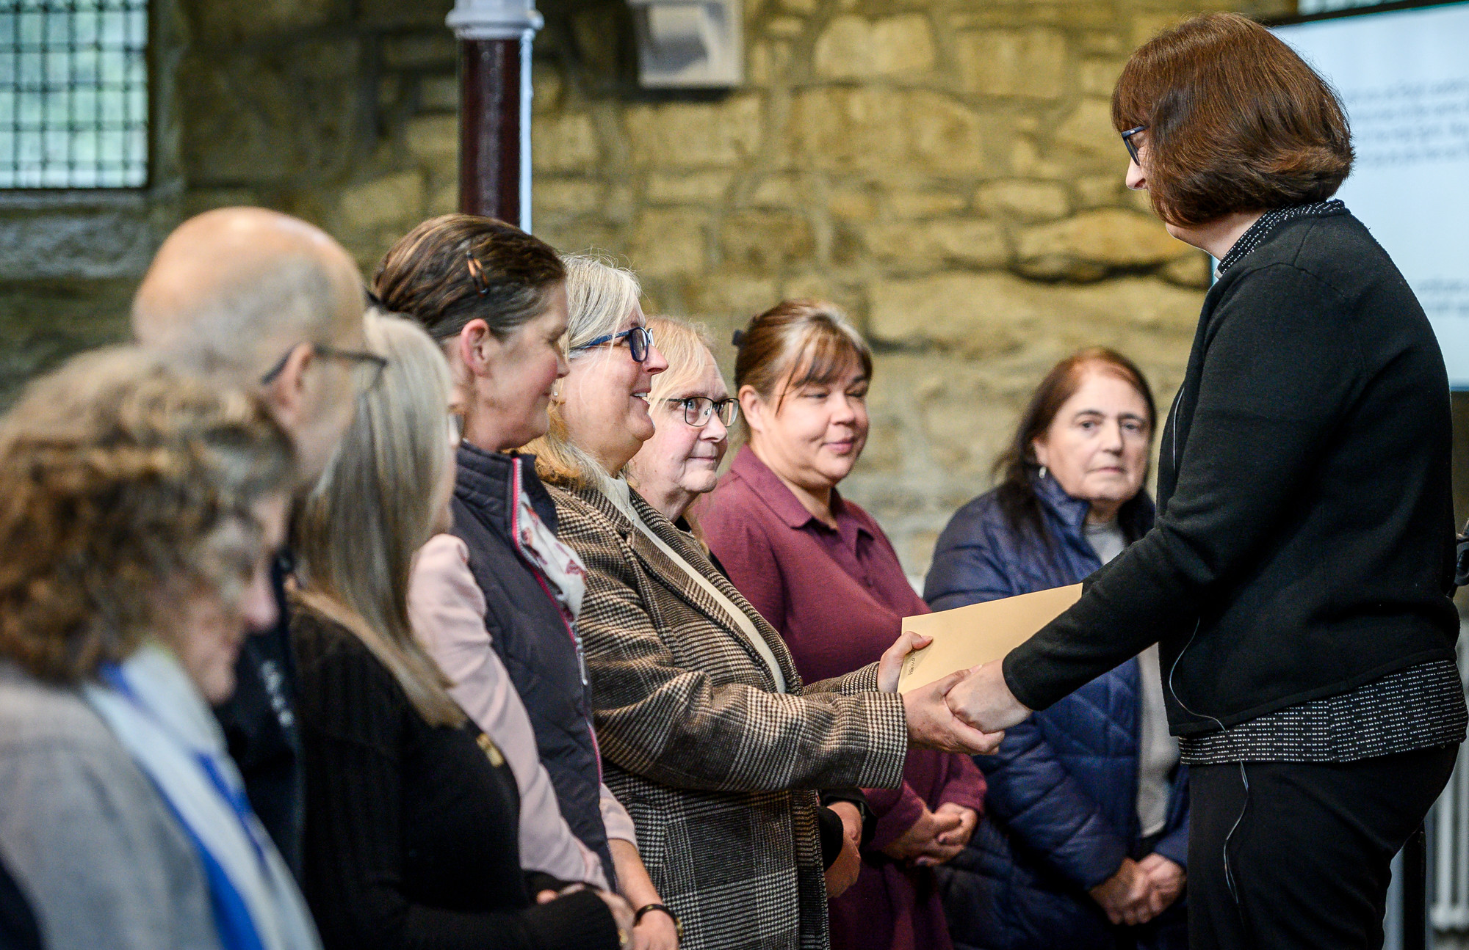
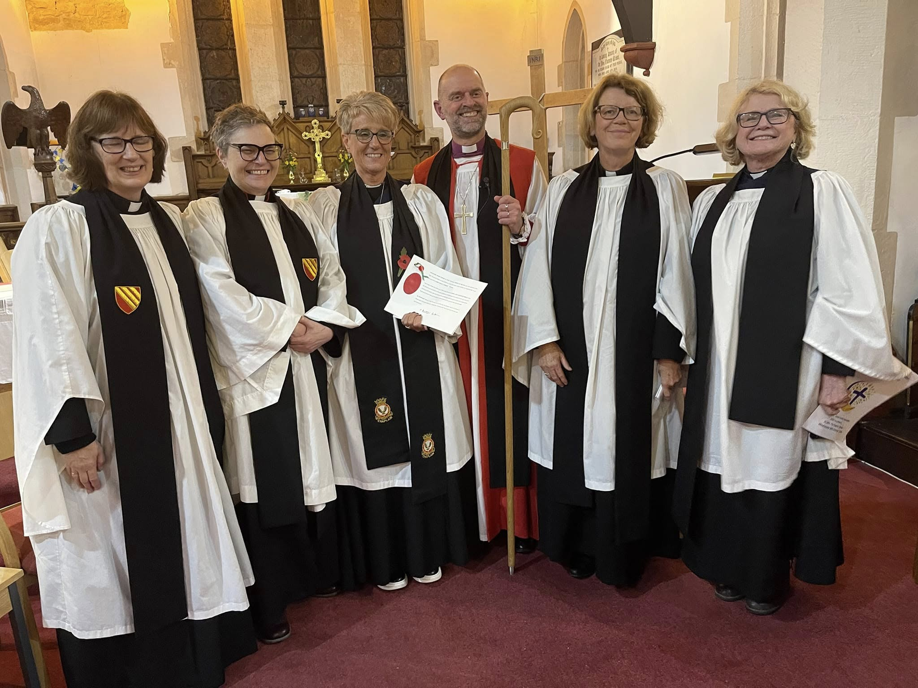
Developing Missional Leaders
We are investing in our clergy so they are equipped to grow our churches, especially given the number of newly ordained clergy who are being appointed to stipendiary roles.
We are developing our lay people, particularly through our Authorised Lay Ministry programme. We have also been taking forward our proposals for focal ministry.
We are supporting clergy and lay vocations so we develop a new, diverse generation of church leaders with the calling and skills to grow new faith communities.

Slide 8
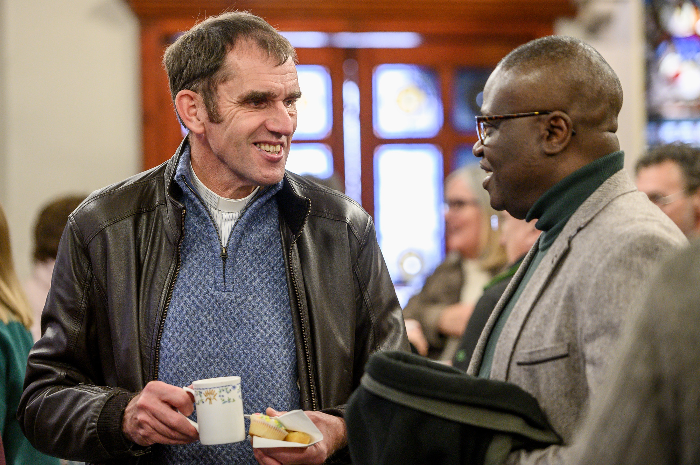
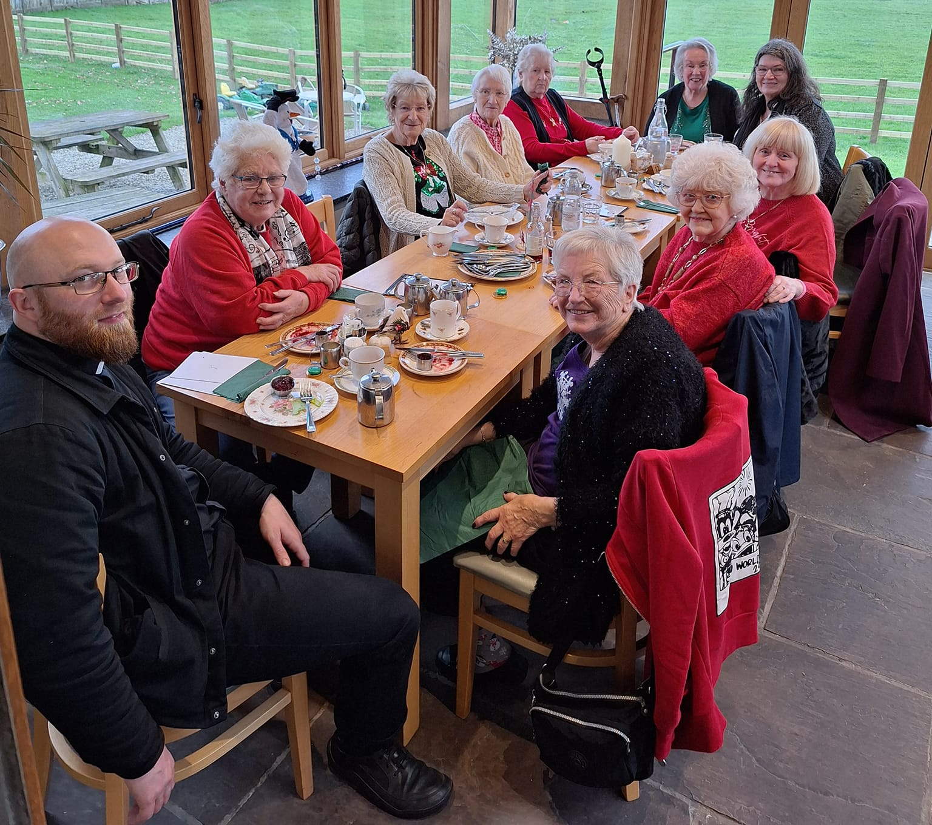
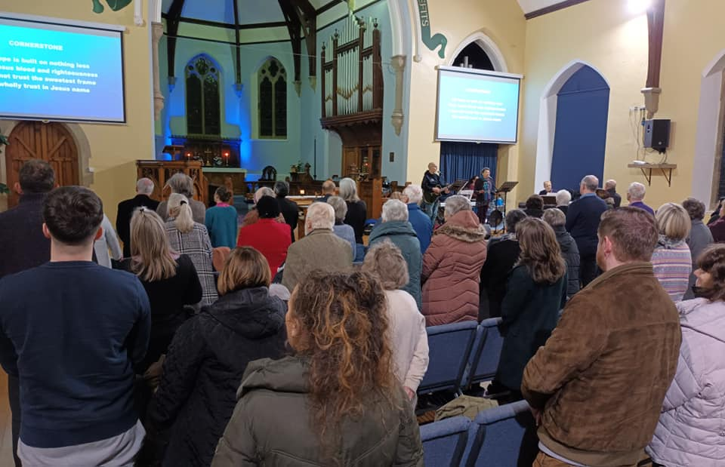
Parish Renewal
We are providing direct support to our parishes to ensure they are missionally focused and their financially sustainable.
Our Area Deans and Lay Chairs are working closely with our parishes, ensuring they have access to the support they need.
Mission communities are enabling parishes to work together on mission and ministry. Clergy deployment, parochial reorganisation and supporting our most fragile churches are important.

Slide 9
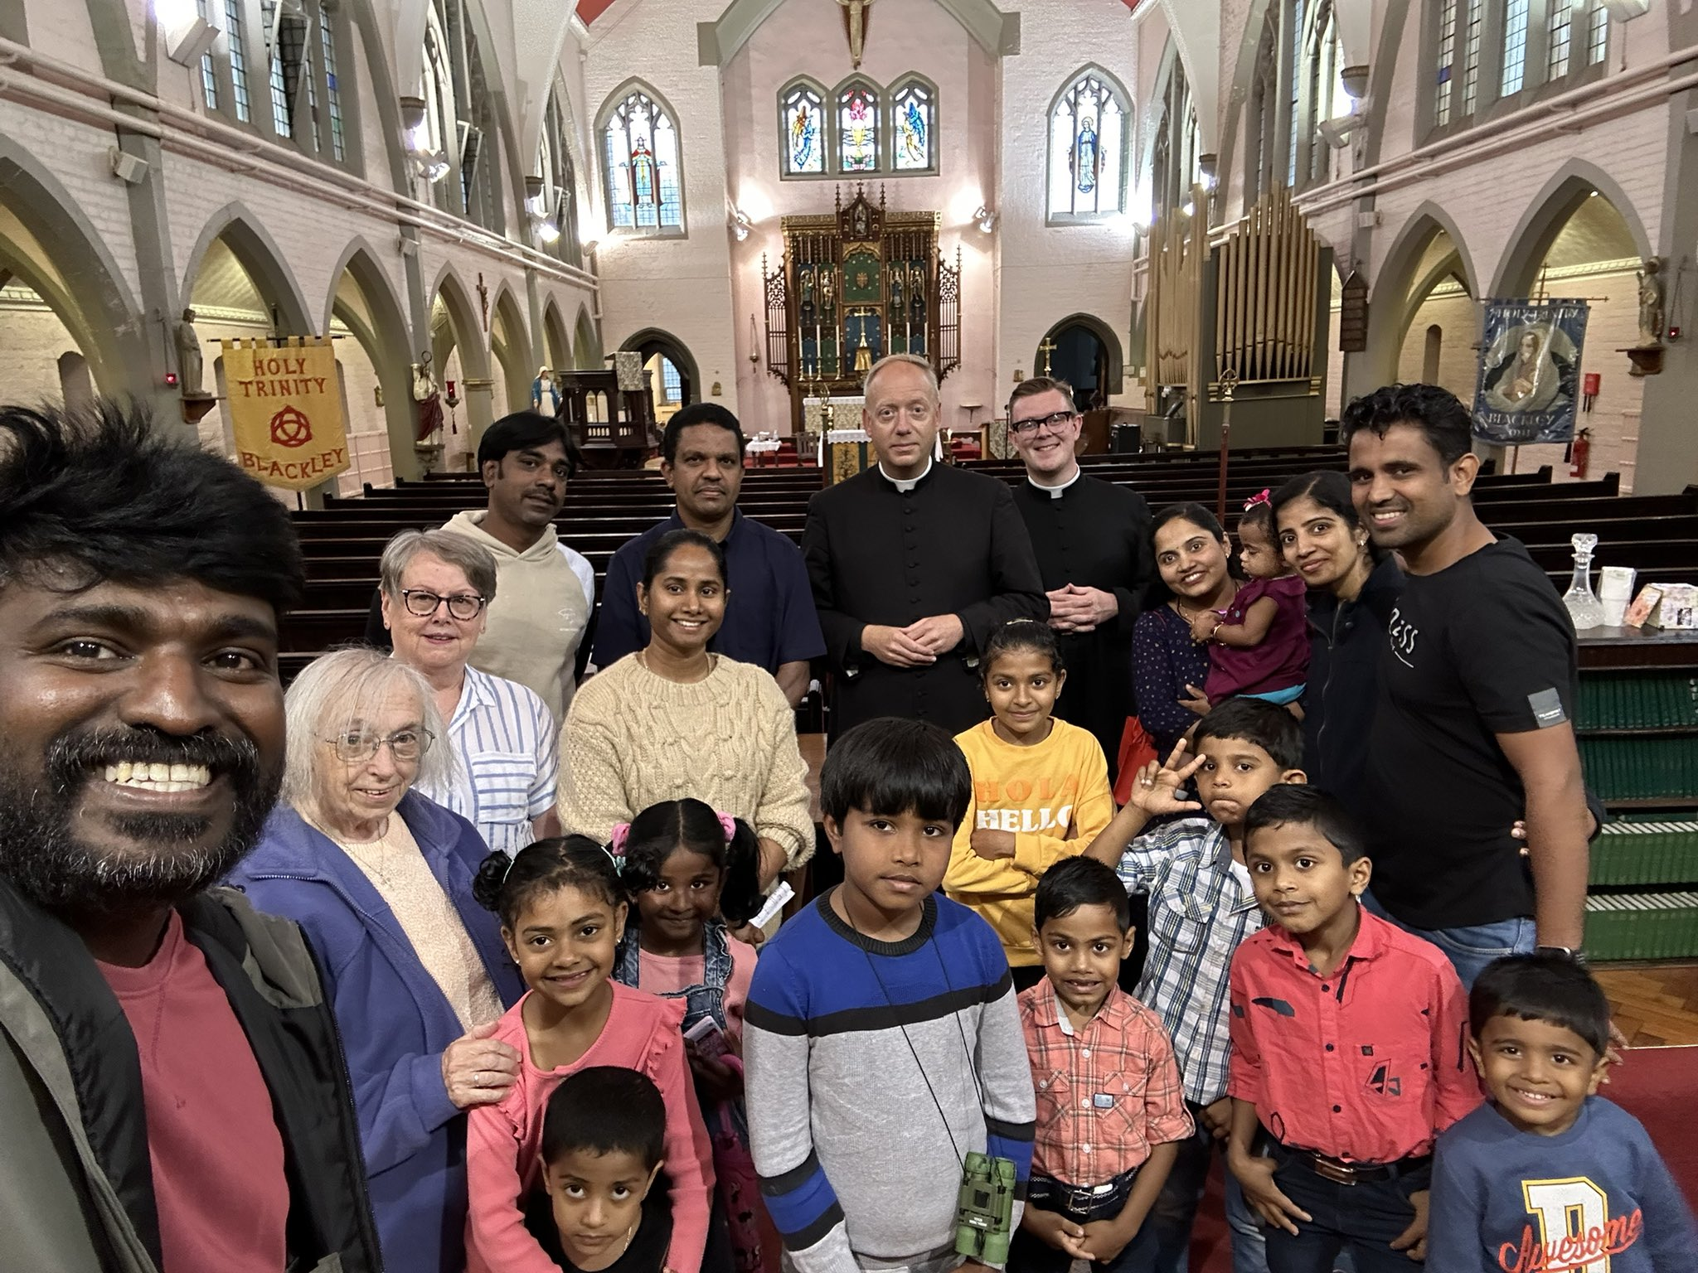
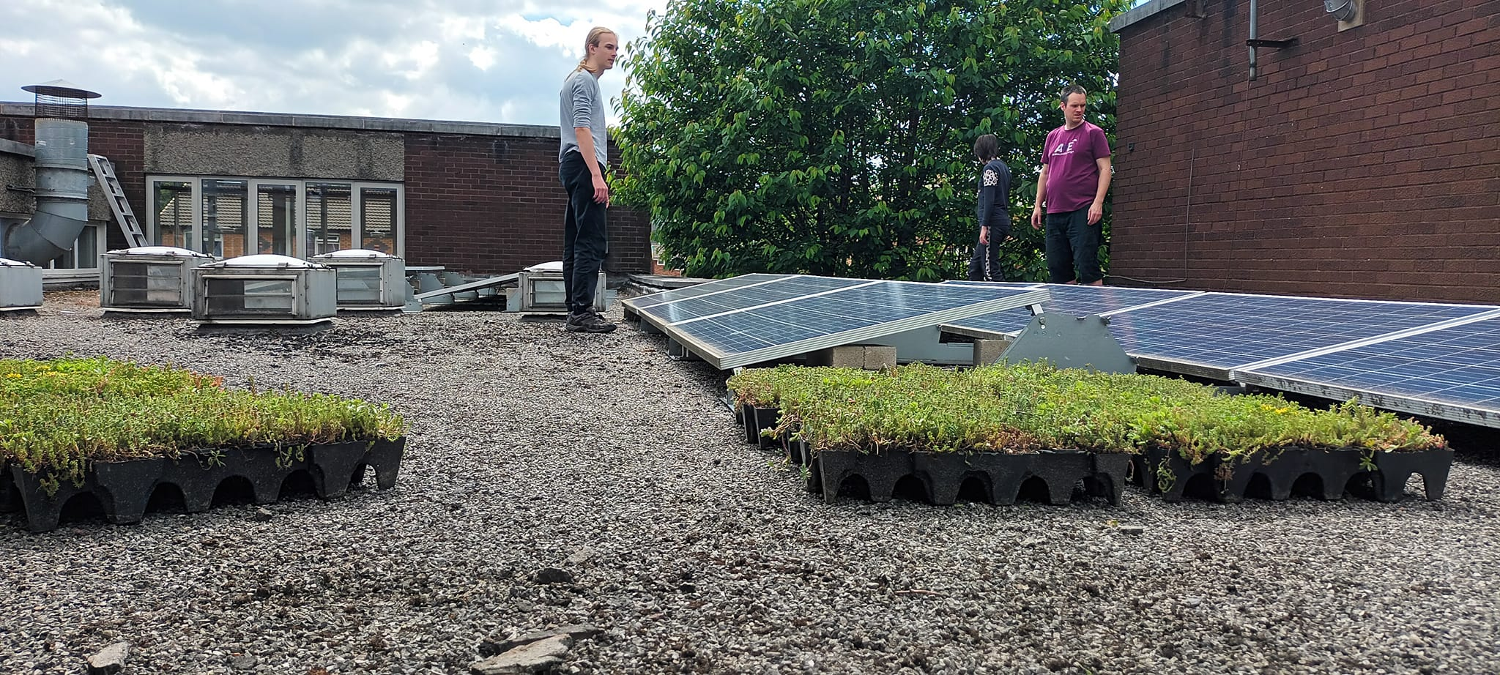
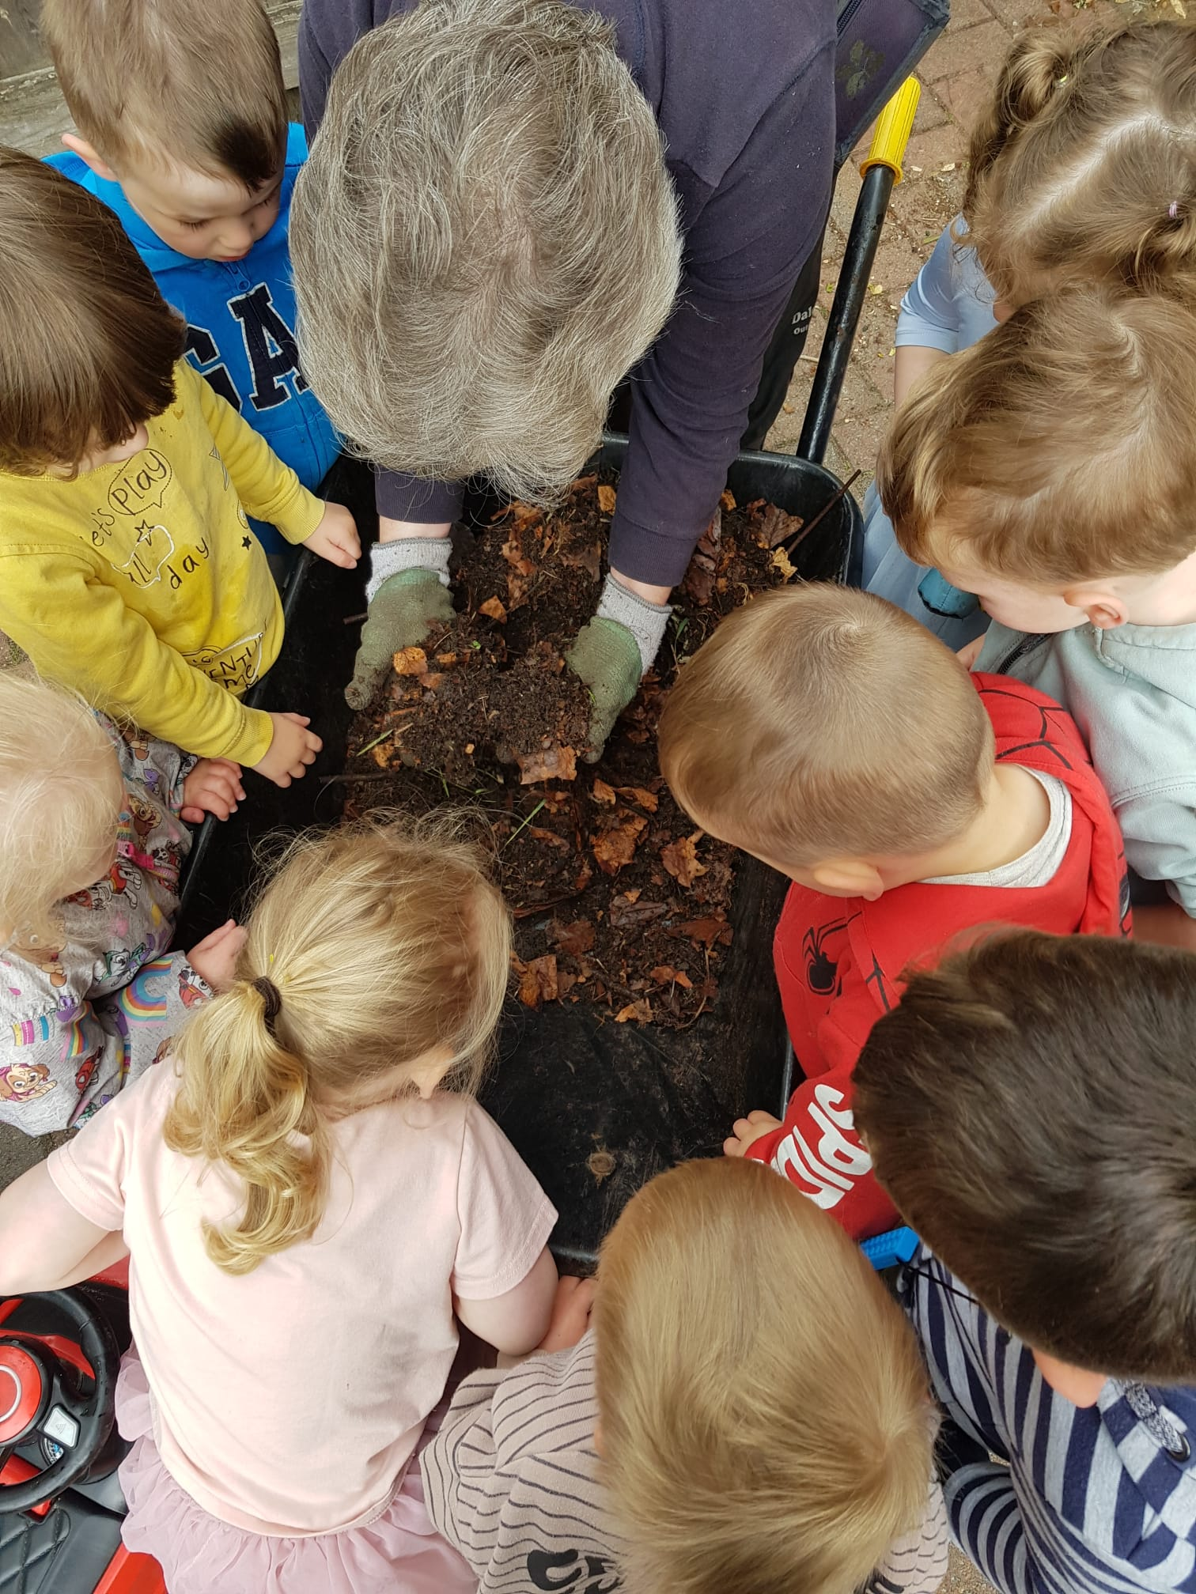
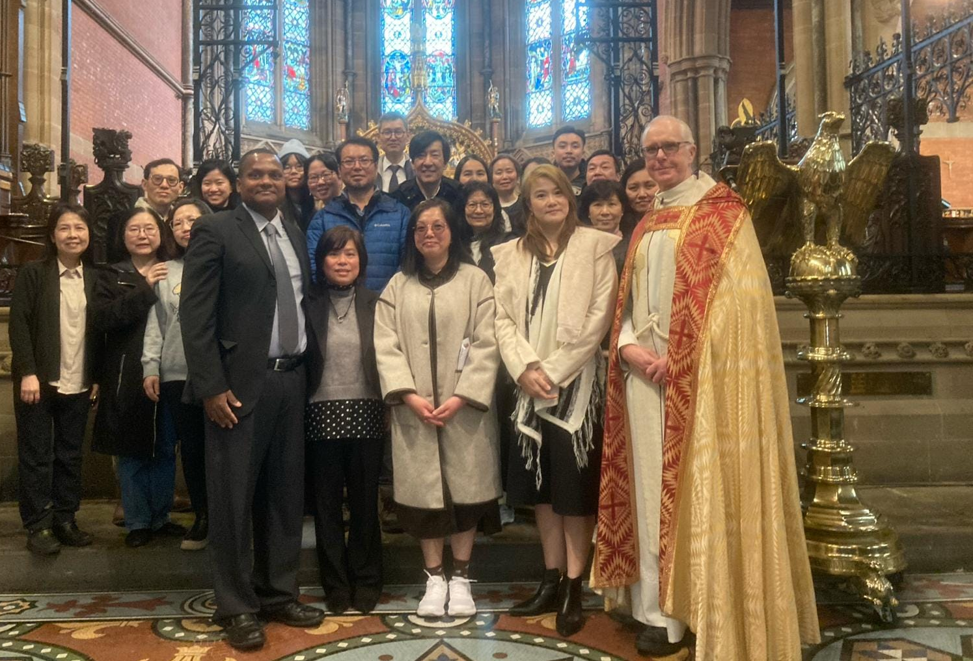
Racial Justice, Net Zero Carbon and Safeguarding
Supporting our international congregations is key to achieving racial justice, as is ensuring that governance, clergy and lay roles are representative of the diversity of our diocese.
Together we are continuing our work towards achieving Net Zero Carbon. Our parishes and schools are measuring their energy use and taking simple, practical steps to reduce their carbon footprint.
We continue to provide a safe environment for all by promoting effective safeguarding.

Slide 10
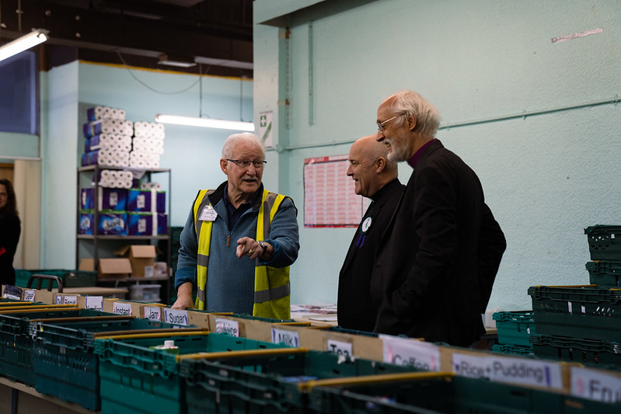
Bid to the Church Commissioners
Over the next 18 months we aim to:
build confidence, enthusiasm and engagement across the diocese for the next phase;
work out our proposals for each of our four priority areas;
and develop the missional design, implementation and resourcing plans which will underpin the bid.
Please let us know your thoughts on this emerging strategy ahead of an extensive stakeholder engagement exercise over the autumn, and the preparation of a bid for funding to the Church Commissioners for submission in December 2025.

Slide 11
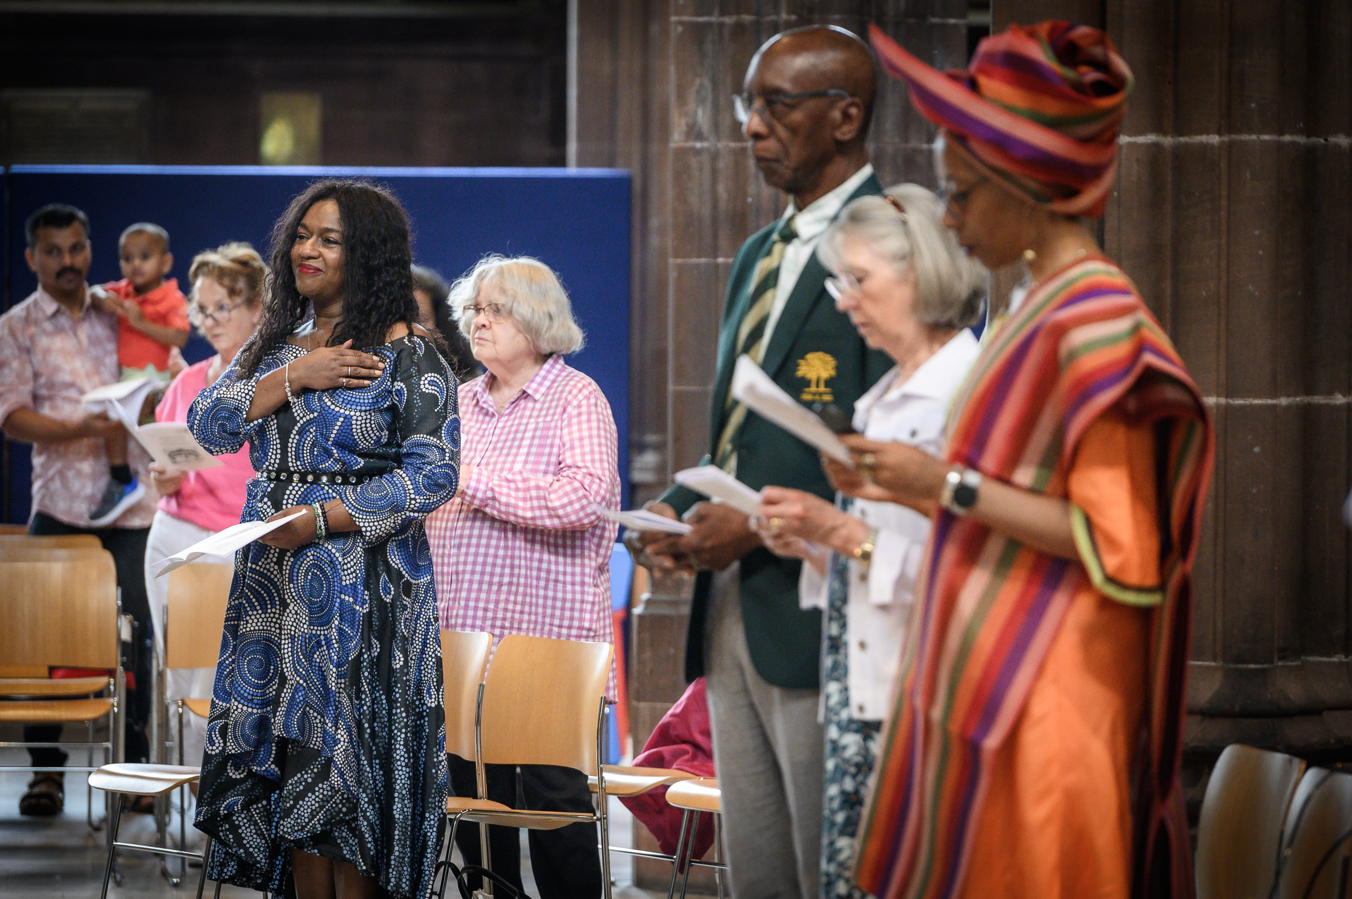
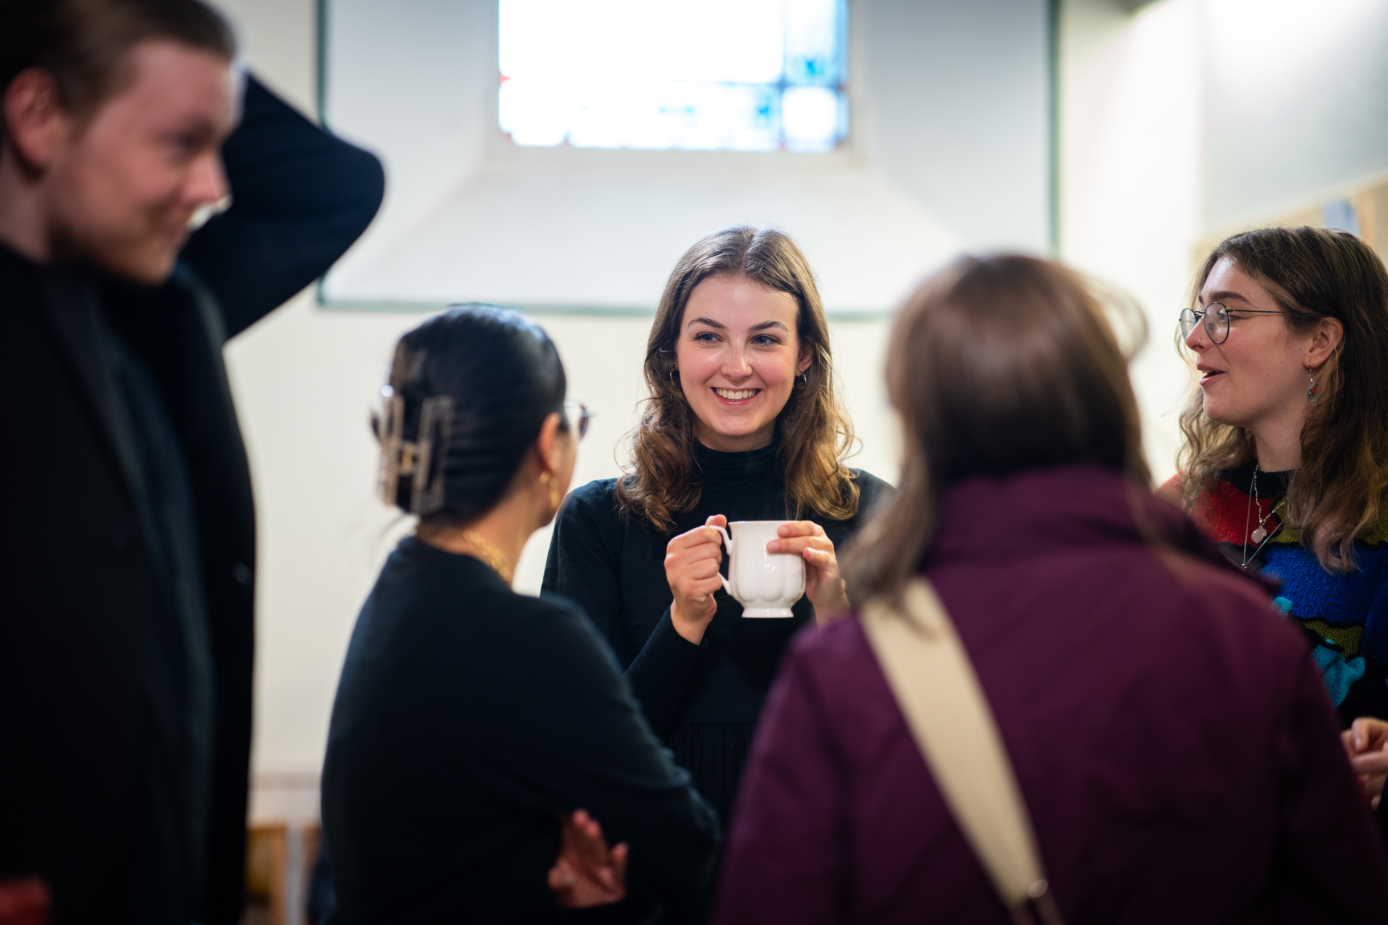
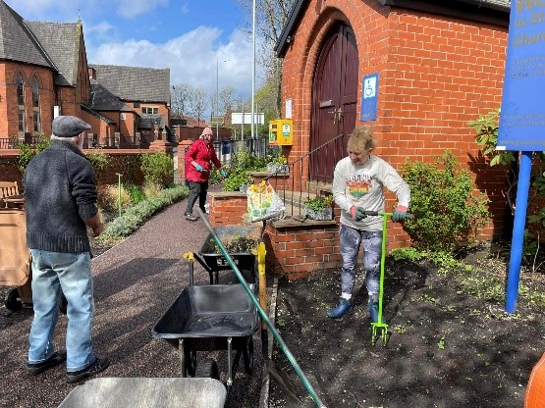
Shaping Future Plans
We are working on creative and ambitious plans for the future and would like your help in shaping them.
God is calling us to go out and make disciples – what inspires you most about our emerging strategy?
As the gospel of Jesus is proclaimed afresh in our generation, how would you like to see your parish develop in the light our emerging strategy?

